Slide 1
Machine Learning for Smart Grid: From Pure Data-Driven to Physics-Informed Methods
Nanpeng Yu, Associate Professor
Director of Energy, Economics, and Environment Research Center
Department of Electrical and Computer Engineering
Department of Computer Science
Department of Statistics
(cooperating faculty)
nyu@ece.ucr.edu
951.827.3688

Slide 2








Team Members and Research Sponsors
Director of Energy, Economics, and Environment (E3) Research Center
  Prof. Nanpeng Yu
Postdoctoral Researchers
  Brandon Foggo (Ph.D. UCR), Yuanqi Gao (Ph.D. UCR)
  Koji Yamashita (Ph.D. MTU), Wenyu Wang (Ph.D. UCR)
Ph.D. Students
  Yuanbin Cheng (M.S. USC), Osten Anderson (B.S. UCLA)
  Yinglun Li (M.S. UCR), Farzana Kabir (B.S. BUET)
  Zuzhao Ye (M.S. Boston University), Xianghao Kong (B.S. HDU)
  Jingtao Qin (M.S. Shandong University)
Research Sponsors and Collaborating Organizations

Slide 3
Outline
Applications of Machine Learning in Smart Grid
  Transmission System and Electricity Market
  Distribution System and End-use Customer
Key Problems Solved by Pure Data-Driven Methods
  Power System Event Detection and Classification Using PMU Data
  Deep Reinforcement Learning-based Distribution System Control
Key Problems Solved by Physics-Informed Methods
  Phase Connectivity Identification, Theft Detection
  Line Parameter Estimation
  Behind-the-meter Solar PV Generation Estimation
Important Takeaway

Slide 4

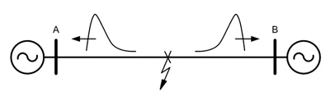

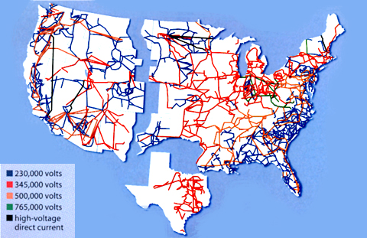

Applications of Machine Learning in
Transmission Systems
Electricity Market Applications
Price & Load Forecasting, Algorithmic Trading
Fault Location
Fault Location using PMU
Wide-area monitoring
Phase angle monitoring
Oscillation detection
Model Validation
Equipment, Generation, Power System
Equipment Monitoring
Identify Equipment/Substation Problems
State Estimation
Linear State Estimation

Slide 5

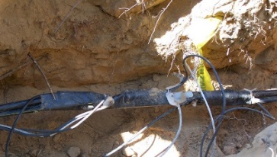
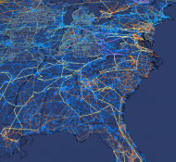
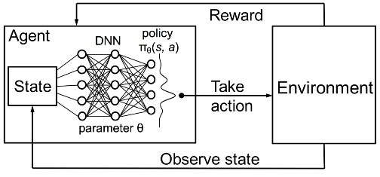
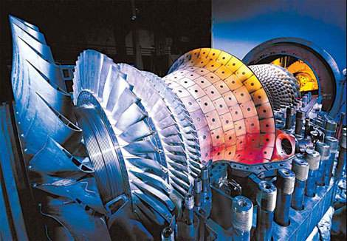

Applications of Machine Learning in
Power Distribution Systems
Spatio-temporal Forecasting
Electric Load / DERs – Short-Term / Long-Term
Anomaly Detection
Electricity Theft, Unauthorized Solar Interconnection
System Monitoring
State Estimation & Visualization
Distribution System Controls
Deep Reinforcement Learning
Network Topology and Parameter Identification
Transformer-to-customer, Phase connectivity, Impedance estimation
Equipment Monitoring
Predictive Maintenance
Online Diagnosis
Customer Behavior Analysis
Customer segmentation, nonintrusive load monitoring, demand response

Slide 6
Outline
Applications of Machine Learning in Smart Grid
  Transmission System and Electricity Market
  Distribution System and End-use Customer
Key Problems Solved by Pure Data-Driven Methods
  Power System Event Detection and Classification Using PMU Data
  Deep Reinforcement Learning-based Distribution System Control
Key Problems Solved by Physics-Informed Methods
  Phase Connectivity Identification, Theft Detection
  Line Parameter Estimation
  Behind-the-meter Solar PV Generation Estimation
Important Takeaway

Slide 7
Motivation and Key Technical Methods
Motivation
  Online event detection & classification is crucial to enhancing the reliability of power system.
  When power system events are correctly detected & classified in a timely manner, appropriate corrective control actions can be taken by operators.
  With access to large amounts of real-world PMU data, we develop an accurate DNN-based power system event identification and classification algorithm.
Key Technical Methods
  To deal with high-dimensional PMU input, adopt the CNN as the base model
  To make parameter sharing more effective in CNN, we propose a graph signal processing based PMU sorting algorithm that systematically arranges PMUs in the input tensor
  To further improve accuracy, we propose an information loading-based regularization technique to control the amount of information compression in the DNN.

Slide 8
Problem Formulation and Overall Framework
Power system event identification is formulated as a classification problem
  No event, line event, generator event, oscillation event
Input: 3 dimensional tensor
  Time, PMU ID, and PQ|V|f measurement
Overall Framework
  Three key modules
    Convolutional Neural Network based Classifier
    Graph Signal Processing based PMU Sorting
    Information Loading based Regularization

Slide 9
Graph Signal Processing based PMU Sorting
Goal: Make parameter sharing more effective.
The GSP based PMU sorting algorithm is proposed to systematically rearrange PMUs in the input tenors.
Main Idea: Strategically place highly correlated PMUs close to each other.
  Visualization of Spatial Correlation Matrix

Slide 10
Information Loading based Regularization
Background
  Abstract Representation of Deep Neural Network based Classifier
Main Idea
  Controls the amount of information compression between the input layer and the last hidden layer of a deep neural network.
  Balance memorization and generalization.
Algorithm
  Augment the typical cross-entropy loss function with estimated mutual information between the input layer and the hidden representation
Low entropy input feature space
High entropy input feature space
Brandon Foggo, Nanpeng Yu, Jie Shi and Yuanqi Gao, "Information Losses in Neural Classifiers from Sampling," IEEE Transactions on Neural Networks and Learning Systems, vol. 31, no. 10, pp. 4073-4083, 2020.

Slide 11
Overall Neural Network Architecture
Neural Classifier, Mutual Information Estimator, Loss Function Augmentation
Jie Shi, Brandon Foggo, and Nanpeng Yu, "Power System Event Identification based on Deep Neural Network with Information Loading," to appear in IEEE Transactions on Power Systems, https://arxiv.org/abs/2011.06718, 2021.

Slide 12
Numerical Study Results
Dataset Description
  2 years of PMU data from Eastern Interconnection
  1247 Labeled Event
  187 PMUs
Data Augmentation
Performance on Validation Data
Illustration of Sub-tensor Sampling

Slide 13
Testing Results and Learned Representation
F1 Scores on Testing Dataset
Learned Representation
Comparison of representations produced by different methods after PCA based dimension reduction

Slide 14
Power System Event Identification with Transfer Learning - Can Events from Eastern Interconnect Help Identify Events from Western Interconnect?
Motivation
  Although deep neural network-based power system event detection and classification algorithms achieved high accuracy, they often require a large amount of power system event training labels and long training time.
  If a transmission grid operator only has limited event labels, then it is difficult to achieve high event classification accuracy.
  Training a neural network from scratch is time and resource consuming.
Main Idea
  Accelerate the training of a model for a new transmission grid by exploiting the information from a previously trained model for a different transmission network.
  Does the neural network trained to identify power system events for the Eastern Interconnection provide useful information and guidance when building the event identification engine for the Western Interconnection?”
  Yes!

Slide 15
Overall Framework of Power System Event Identification with Transfer Learning
The learned parameters of the first classifier is used as the initial values of the second model.
Transfer the parameters of the convolution filter.

Slide 16
Numerical Results
Transfer learning significantly reduces the required training time to reach a desirable event classification accuracy level.
Transfer learning helps shrink the uncertainty bounds, especially during the early stage of training.
The comparative advantage of using transfer learning is more pronounced when the system operator has a limited amount of training sample.

Slide 17
Outline
Applications of Machine Learning in Smart Grid
  Transmission System and Electricity Market
  Distribution System and End-use Customer
Key Problems Solved by Pure Data-Driven Methods
  Power System Event Detection and Classification Using PMU Data
  Deep Reinforcement Learning-based Distribution System Control
Key Problems Solved by Physics-Informed Methods
  Phase Connectivity Identification, Theft Detection
  Line Parameter Estimation
  Behind-the-meter Solar PV Generation Estimation
Important Takeaway

Slide 18
Motivation
Physical Model-based Control in Power Distribution Systems
  Advantages: theoretical guarantees for control performance in ideal scenarios
  Rely heavily on accurate knowledge of distribution grid topology and parameter, which are often unreliable
  Unsatisfactory performance in practice (e.g., prevalent voltage violation)
Reinforcement Learning-based (Model-free) Approach
  Do not need reliable and complete distribution network model
  Use optional (real-time, historical) data to learn control policies
  Improves the performance of any existing controller(s) by interacting with the grid
  Challenges: safety, sample efficiency, robustness, optimality

Slide 19
Background: Distribution System Control Problems
Volt-VAR Control
  Objectives: Maintain voltages within allowable range, reduce loss, minimize equipment wear and tear
  Two timescale VVC: Slow timescale and fast timescale
  Central & decentralized control
Network Reconfiguration
  Objectives: Reduce network loss and operating costs of switches, minimize loss of load and increase hosting capacity of DERs
  Static & dynamic distribution network reconfiguration
Operational Constraints
  Voltage magnitude limits
  Network radiality

Slide 20
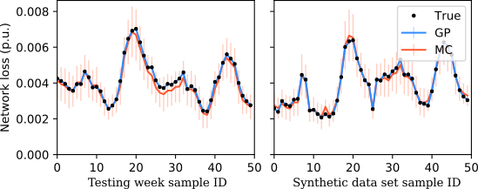
Experience Augmentation
Motivation: Major drawback of existing DRL algorithms is poor sample efficiency
Solution: Generate reliable synthetic operational experience data from historical data
Key Idea
  Adopt Gaussian process to learn reward values and uncertainties associated with operational experience (network loss, voltage magnitude)
  Discard the synthetically generated operational experience data that is highly uncertain
When augment the historical operational experiences with synthetic operational data, the operational cost of the DQN algorithm further reduces.
Yuanqi Gao, Jie Shi, Wei Wang, and Nanpeng Yu, "Dynamic distribution network reconfiguration using reinforcement learning." in 2019 IEEE International Conference on Smart Grid Communications (SmartGridComm), pp. 1-7. IEEE, 2019.

Slide 21
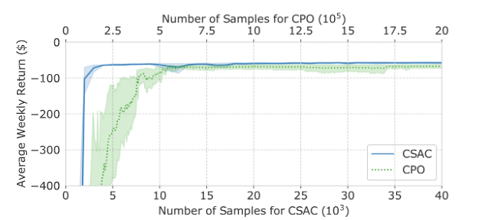
Safe RL and Ordinal Encoding
Motivation: control actions took by RL agent must satisfy operational constraints
Solution: formulate the distribution system control problem by Constrained Markov Decision Process (CMDP)
Improve Sample Efficiency
  Develop a safe off-policy RL algorithm: constrained soft actor-critic (CSAC)
    Synergistically combine method of multiplier with SAC: update Lagrangian multiplier with RL parameter
  Adopt ordinal network structure to encode the natural ordering between discrete actions of voltage regulating devices
    E.g., encode turns ratios of voltage regulator 0.99, 1.0, 1.01 by [1 0 0], [1 1 0], and [1 1 1]
Algorithm | AVR ($) | AVV
 | 123-bus | 123-bus
DQN | NA⁺ | NA⁺
CPO | -68.88 | 1.12
CSAC | -57.43 | 0
MPC | NA* | NA*
MICP | -66.99 | 0
W Wang, N. Yu, J. Shi, and Y. Gao, "Volt-VAR control in power distribution systems with deep reinforcement learning." in 2019 IEEE International Conference on Smart Grid Communications (SmartGridComm), pp. 1-7. IEEE, 2019.
W. Wang, N. Yu, Y. Gao and J. Shi, "Safe Off-Policy Deep Reinforcement Learning Algorithm for Volt-VAR Control in Power Distribution Systems," in IEEE Transactions on Smart Grid, vol. 11, no. 4, pp. 3008-3018, July 2020.

Slide 22
Batch-Constrained RL
Motivation
  Costly & time consuming to learn optimal control strategy by directly interacting with physical network.
  Learning from a finite historical dataset lead to large extrapolation errors.
Solution: Batch-constrained soft actor-critic algorithm
Key Idea: train a control policy
  Maximize the total discounted return
  Minimize dissimilarity between learned control policy & behavior policy of the batch data
Weekly Operational Cost of test feeder
Yuanqi Gao, Wei Wang, Jie Shi, and Nanpeng Yu, "Batch-constrained Reinforcement Learning for Dynamic Distribution Network Reconfiguration," IEEE Transactions on Smart Grid, vol. 11, no. 6, pp. 5357-5369, https://arxiv.org/abs/2006.12749 , 2020.

Slide 23
Consensus Multi-agent RL
Each Volt-VAR controller managed by a separate RL agent
Each agent learns two models: global state value function & local policy
Control goals: maximize own local reward, minimize difference in state values
Sample efficient and resilient against agent and communication link failure
Y. Gao, W. Wang, and N. Yu, “Consensus Multi-Agent Reinforcement Learning for Volt-VAR Control in Power Distribution Networks", IEEE Transactions on Smart Grid, https://arxiv.org/abs/2007.02991, 2021. DOI: 10.1109/TSG.2021.3058996.

Slide 24
Outline
Applications of Machine Learning in Smart Grid
  Transmission System and Electricity Market
  Distribution System and End-use Customer
Key Problems Solved by Pure Data-Driven Methods
  Power System Event Detection and Classification Using PMU Data
  Deep Reinforcement Learning-based Distribution System Control
Key Problems Solved by Physics-Informed Methods
  Phase Connectivity Identification, Theft Detection
  Line Parameter Estimation
  Behind-the-meter Solar PV Generation Estimation
Important Takeaway

Slide 25
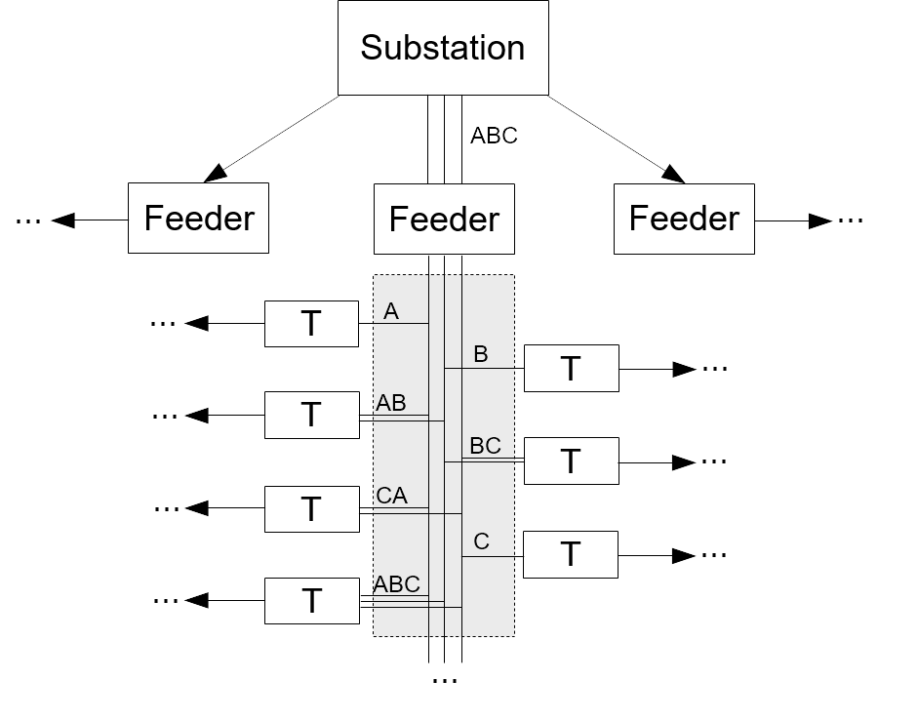
Phase Connectivity Identification
Problem Definition
  Identify the phase connectivity of each smart meter / transformer in the power distribution network.
  Very few electric utility companies have completely accurate phase connectivity information in GIS!
Why is it important?
  Phase connectivity is crucial to an array of distribution system analysis & operation tools including
    3-phase Power flow
    Load balancing, State estimation
    3-phase optimal power flow
    Volt-VAR control
    Network reconfiguration and restoration

Slide 26
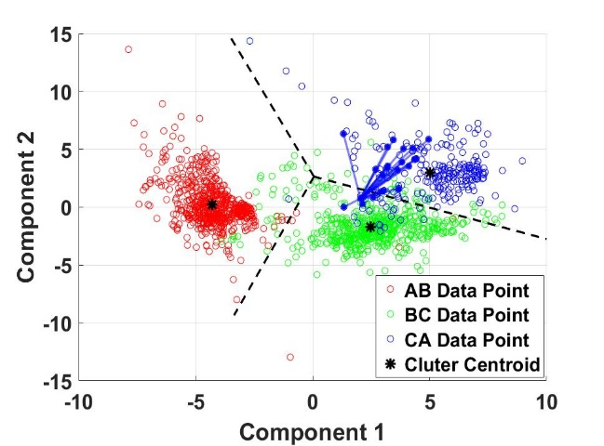
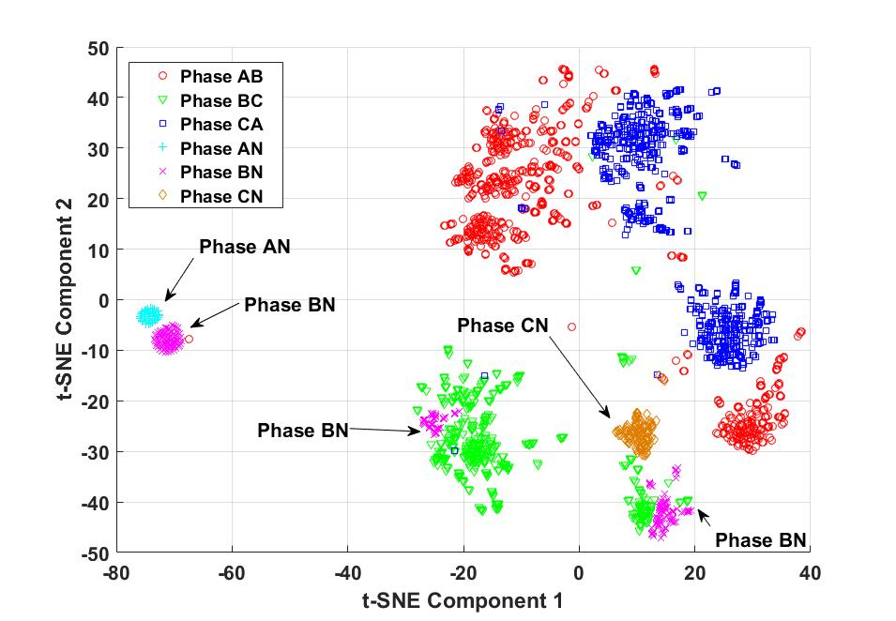
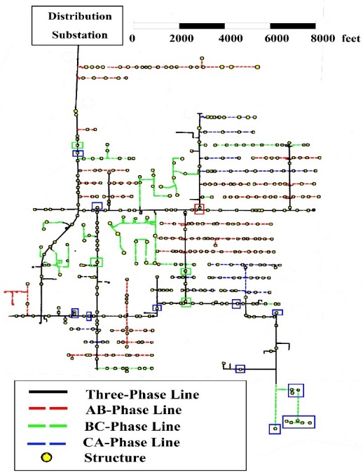
Unsupervised ML Algorithms
Linear Dimension Reduction + Centroid-based Clustering
Nonlinear Dimension Reduction + Density-based Clustering
Feeder | Granularity of Meter Readings
 | 1 hour | 15-minute | 5-minute
1 | 93.62% | 94.32% | 94.40%
2 | 87.55% | 88.86% | 92.03%
3 | 83.94% | 90.02% | 91.56%
Cluster analysis on voltage magnitude measurements from smart meters
Must-link constraints enforced with known primary feeder connection
W Wang, N. Yu, B. Foggo, and J. Davis, "Phase Identification in Electric Power Distribution Systems by Clustering of Smart Meter Data," 15th IEEE International Conference on Machine Learning and Applications (ICMLA), CA, 2016.
W. Wang and N. Yu, "AMI Data Driven Phase Identification in Smart Grid," the Second International Conference on Green Communications, Computing and Technologies, Rome, Italy, Sep. 2017. Received Best Paper Award.

Slide 27
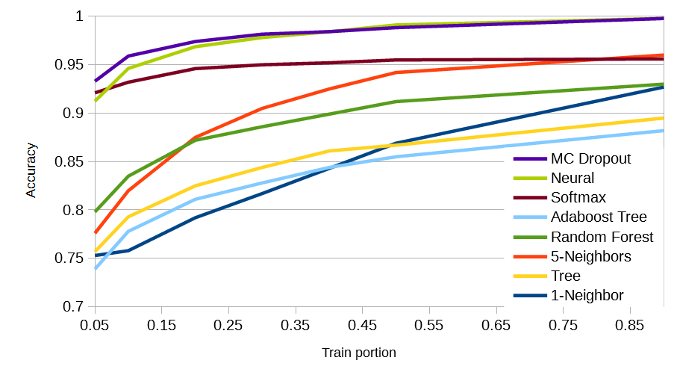
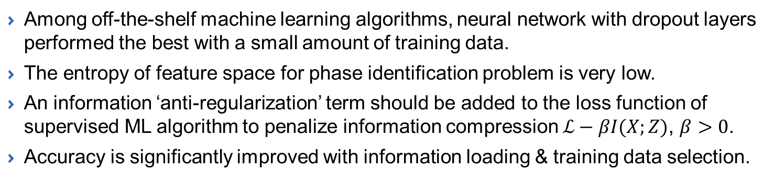
Supervised ML Algorithms
Circuit | Neural Network | Information Load & Training Data Selection
I | 80.7% | 91.0%
II | 64.7% | 96.3%
III | 74.1% | 93.1%
IV | 75.0% | 98.8%
V | 51.7% | 97.3%
Among off-the-shelf machine learning algorithms, neural network with dropout layers performed the best with a small amount of training data.
The entropy of feature space for phase identification problem is very low.
An information ‘anti-regularization’ term should be added to the loss function of supervised ML algorithm to penalize information compression $ℒ−βI(X;Z)$, $β>0$.
Accuracy is significantly improved with information loading & training data selection.
B. Foggo, N. Yu, and W. Wang, "A Comprehensive Evaluation of Supervised Machine Learning for the Phase Identification Problem," 20th International Conference on Machine Learning and Applications, pp.1-9, Copenhagen, Denmark, 2018.
B. Foggo and N. Yu, "Improving Supervised Phase Identification Through the Theory of Information Losses," IEEE Transactions on Smart Grid, vol. 11, pp. 2337-2346, 2020, Digital Object Identifier: 10.1109/TSG.2019.2952080.

Slide 28
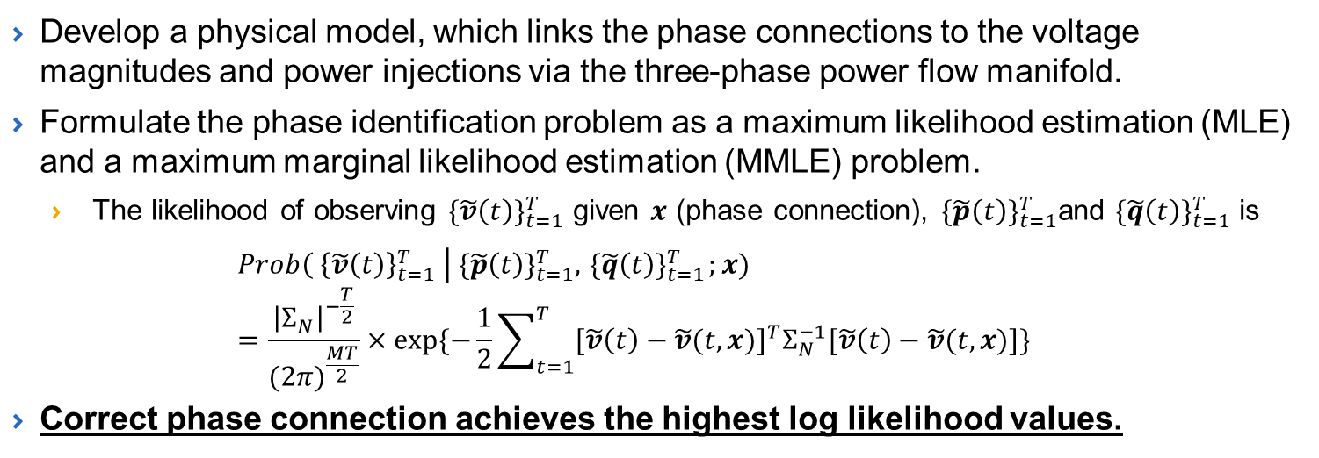
Physics Informed ML
Develop a physical model, which links the phase connections to the voltage magnitudes and power injections via the three-phase power flow manifold.
Formulate the phase identification problem as a maximum likelihood estimation (MLE) and a maximum marginal likelihood estimation (MMLE) problem.
  The likelihood of observing ${\{\tilde{v}\left(t\right)\}}_{t=1}^{T}$ given $x$ (phase connection), ${\{\tilde{p}\left(t\right)\}}_{t=1}^{T}$and ${\{\tilde{q}\left(t\right)\}}_{t=1}^{T}$ is
  $$Prob\left({ \left\{\tilde{v}\left(t\right)\right\}}_{t=1}^{T} \right| {\{\tilde{p}\left(t\right)\}}_{t=1}^{T},{ \{\tilde{q}\left(t\right)\}}_{t=1}^{T};x)=\frac{{\left|Σ_{N}\right|}^{−\frac{T}{2}}}{{(2π)}^{\frac{MT}{2}}}×exp⁡\{−\frac{1}{2}\sum_{t=1}^{T}{{[\tilde{v}\left(t\right)−\tilde{v}(t,x)]}^{T}Σ_{N}^{−1}[\tilde{v}\left(t\right)−\tilde{v}(t,x)]}\}$$
Correct phase connection achieves the highest log likelihood values.
Feeder | Meter Class | 30 days | 60 days | 90 days
37-bus (radial) | 0.1% | 100% | 100% | 100%
 | 0.2% | 92% | 100% | 100%
123-bus (radial) | 0.1% | 96.47% | 100% | 100%
 | 0.2% | 63.53% | 96.47% | 100%
342-bus (meshed) | 0.1% | 96.63% | 100% | 100%
 | 0.2% | 72.60% | 99.52% | 100%
W. Wang and N. Yu, "Maximum Marginal Likelihood Estimation of Phase Connections in Power Distribution Systems," IEEE Transactions on Power Systems, vol. 35, no. 5, pp.3906-3917, Sep. 2020.

Slide 29
Summary of Phase ID Technology
 | Unsupervised ML | Supervised ML | Physics-informed ML
Smart Meter Data | Voltage magnitude (required) | Voltage magnitude (required) | Voltage magnitude, real power (required), reactive power (optional)
Correct Phase Labels for Transformers/Meters | Not needed | Needed for a small percentage of meters | Not required
Primary Feeder Model and Point of Connection for Smart Meters | Not needed | Not needed | Require physical primary feeder model & point connection info for meters
Accuracy* | > 84% (hourly data) > 90% (15-minute) > 92% (5-minute) | > 92% (hourly data with 5% training labels) | > 96.5% (30 days hourly data, 0.1% meter class) = 100% (60 days hourly data, 0.1% meter class)
* Accuracy depends many physical characteristics of the feeder such as the number of phase connections, level of unbalanceness, and data quality. The accuracy numbers are based on the worst case results from over 100 real-world distribution feeders in U.S.

Slide 30
Outline
Applications of Machine Learning in Smart Grid
  Transmission System and Electricity Market
  Distribution System and End-use Customer
Key Problems Solved by Pure Data-Driven Methods
  Power System Event Detection and Classification Using PMU Data
  Deep Reinforcement Learning-based Distribution System Control
Key Problems Solved by Physics-Informed Methods
  Phase Connectivity Identification, Theft Detection
  Line Parameter Estimation
  Behind-the-meter Solar PV Generation Estimation
Important Takeaway

Slide 31
Electricity Theft Detection
Problem Definition
  Energy Theft: The activity of reducing electricity bill by altering the electricity consumption (physical / cyber)
    Physical: Bypassing the smart meter, tamper electricity meters
    Cyber: Hack into meters, communication network to change kWh readings
Why is it important? (Business Value)
  According to Northeast Group, LLC, the world loses $89.3 billion annually to electricity theft in 2015 (India $16.2 billion).
  In the North America energy theft costs between 0.5% and 3.5% of annual gross revenue.
  B.C. Hydro estimates up to 3% of energy theft with 1500 ‘electrical diversions’ caught in 3 years. Center Point estimates energy theft is 1% to 2%.
  Traditional detection methods rely on labor intensive inspections.

Slide 32
Physically Informed Data-Driven Method
There exists linear models between power and voltage magnitudes to distribution secondaries.
  Find a tangent plane to power flow manifold centered at a suitable point.
Establishes an exploitable relationship between theft data and honest data.
  Theft data has large negative residuals and the summation of all customers on the same secondary is zero.
The proposed algorithm does not depend on training samples for theft cases nor a complete network topology documentation.
  Yuanqi Gao, Brandon Foggo, and Nanpeng Yu, "A Physically Inspired Data-driven Model for Electricity Theft Detection with Smart Meter Data," in IEEE Transactions on Industrial Informatics, 2018. doi: 10.1109/TII.2019.2898171.

Slide 33
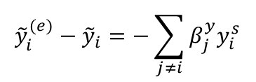

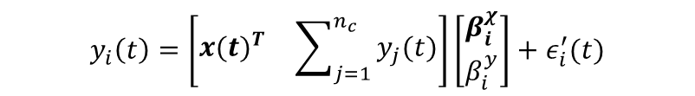
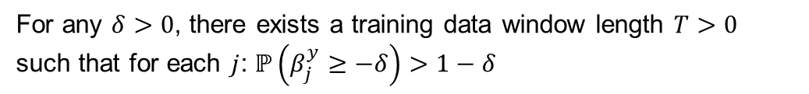
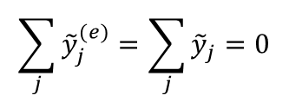
Physical Model and Properties of Residuals
Physics-informed Model for Estimating Power Consumption
$$y_{i}\left(t\right)=\left[\begin{matrix}{x(t)}^{T} & \sum_{j=1}^{n_{c}}{y_{j}(t)}\end{matrix}\right]\left[\begin{matrix}β_{i}^{χ} \\ β_{i}^{y}\end{matrix}\right]+ε_{i}^{′}(t)$$
Where $x\left(t\right)={[1,v_{1}\left(t\right),v_{2}\left(t\right),⋯,v_{n_{c}}\left(t\right)]}^{T}$, $y_{i}\left(t\right)=p_{i}(t)$
Suppose without loss of generality that customer $i$ is the thief, then
$y_{i}^{(e)}=y_{i}−y_{i}^{s}$ $y_{j}^{(e)}=y_{j} ∀j≠i$
Let ${\tilde{y}}_{i}^{(e)}$ and ${\tilde{y}}_{i}$ denote the out-of-sample residual time series for the energy thief
Then the following results hold
$${\tilde{y}}_{i}^{(e)}−{\tilde{y}}_{i}=−\sum_{j≠i}{β_{j}^{y}y_{i}^{s}}$$
Lemma 1.
Lemma 2.
$$\sum_{j}{{\tilde{y}}_{j}^{(e)}}=\sum_{j}{{\tilde{y}}_{j}}=0$$
Lemma 3.
For any $δ>0$, there exists a training data window length $T>0$ such that for each $j$: $ℙ\left(β_{j}^{y}≥−δ\right)>1−δ$
Lemma 1 and Lemma 3 combine to show that a thief’s residuals will become negative once he or she begins to steal power.
Lemma 2 shows that the residuals of the other customers will raise to balance their sum.

Slide 34
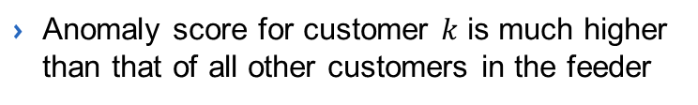
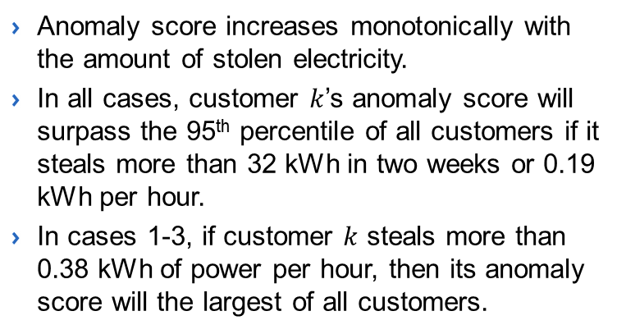
Numerical Results with Real-world Meter Data
12 KV distribution circuit, 6 months of smart meter data from 980 customers and 190 transformers with synthetic theft cases.
The average electric load consumed by the customer is 1.6 kWh.
The mean of the estimation residual is -0.01 kWh and its standard deviation is 0.1 kWh.
Anomaly score for customer $k$ is much higher than that of all other customers in the feeder
Anomaly score increases monotonically with the amount of stolen electricity.
In all cases, customer $k$’s anomaly score will surpass the 95th percentile of all customers if it steals more than 32 kWh in two weeks or 0.19 kWh per hour.
In cases 1-3, if customer $k$ steals more than 0.38 kWh of power per hour, then its anomaly score will the largest of all customers.

Slide 35
Outline
Applications of Machine Learning in Smart Grid
  Transmission System and Electricity Market
  Distribution System and End-use Customer
Key Problems Solved by Pure Data-Driven Methods
  Power System Event Detection and Classification Using PMU Data
  Deep Reinforcement Learning-based Distribution System Control
Key Problems Solved by Physics-Informed Methods
  Phase Connectivity Identification, Theft Detection
  Line Parameter Estimation
  Behind-the-meter Solar PV Generation Estimation
Important Takeaway

Slide 36
Background & Key Idea
Accurate estimations of distribution network parameters are essential.
Objective of network parameter estimation
  Infer the series impedances of distribution lines based on network topology information and data from smart meters, SCADA system and/or micro-PMUs.
Key Idea: Embed physical equations of power flow in the graphical learning model
  Inspired by graphical neural network (GNN)
Difference between physics-informed GL and GNN
  Leverage three-phase power flow-based physical transition functions to replace the deep neural networks in GNN.
Key Step: Derive the gradient of voltage magnitude loss function w.r.t. line segment’s resistance and reactance parameters with an iterative method.
Estimate distribution line parameters with SGD considering prior estimates of line parameters and physical constraints.

Slide 37
Overall Framework of Graphical Learning Model
Inputs to GL engine
Node → Physical Bus
Nodal state
Output of GL model
Loss function
SGD-based parameter updates
Wenyu Wang and Nanpeng Yu “Estimate three-phase distribution line parameters with physics-informed graphical learning method”, under review, IEEE Transactions on Power Systems, 2021. https://arxiv.org/pdf/2102.09023.pdf

Slide 38
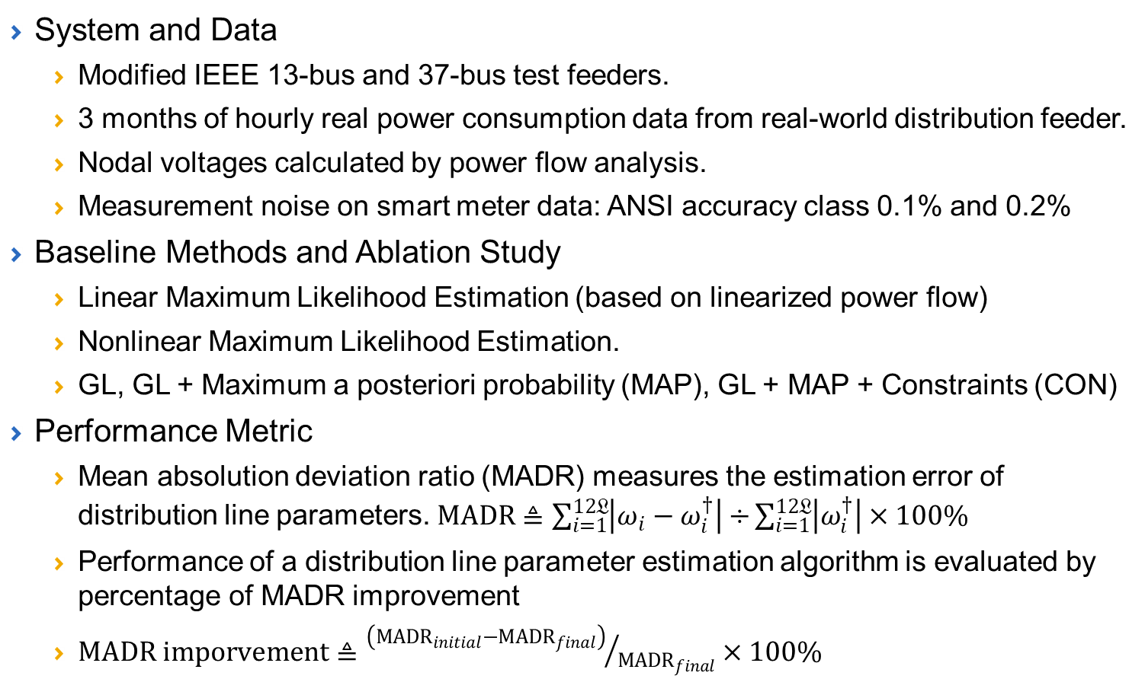
Numerical Study Setup
System and Data
  Modified IEEE 13-bus and 37-bus test feeders.
  3 months of hourly real power consumption data from real-world distribution feeder.
  Nodal voltages calculated by power flow analysis.
  Measurement noise on smart meter data: ANSI accuracy class 0.1% and 0.2%
Baseline Methods and Ablation Study
  Linear Maximum Likelihood Estimation (based on linearized power flow)
  Nonlinear Maximum Likelihood Estimation.
  GL, GL + Maximum a posteriori probability (MAP), GL + MAP + Constraints (CON)
Performance Metric
  Mean absolution deviation ratio (MADR) measures the estimation error of distribution line parameters. $MADR≜\sum_{i=1}^{12𝔏}{\left|ω_{i}−ω_{i}^{†}\right|÷}\sum_{i=1}^{12𝔏}{\left|ω_{i}^{†}\right|}×100\%$
  Performance of a distribution line parameter estimation algorithm is evaluated by percentage of MADR improvement
  $MADR imporvement≜{\left({MADR}_{initial}−{MADR}_{final}\right)}/{{MADR}_{final}}×100\%$

Slide 39
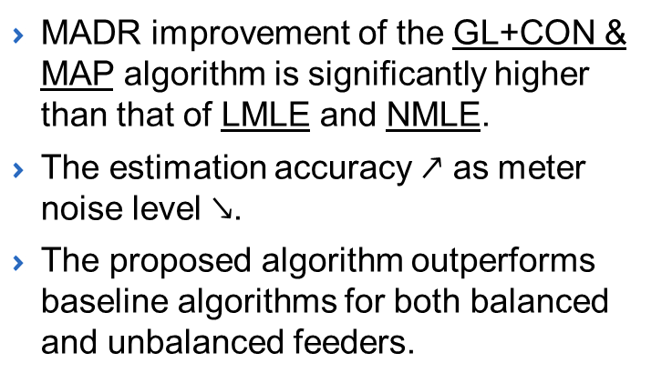
Numerical Study Results
Avg. MADR Improvement of Parameter Estimation Methods
MADR improvement of the GL+CON & MAP algorithm is significantly higher than that of LMLE and NMLE.
The estimation accuracy $↗$ as meter noise level $↘$.
The proposed algorithm outperforms baseline algorithms for both balanced and unbalanced feeders.

Slide 40
Outline
Applications of Machine Learning in Smart Grid
  Transmission System and Electricity Market
  Distribution System and End-use Customer
Key Problems Solved by Pure Data-Driven Methods
  Power System Event Detection and Classification Using PMU Data
  Deep Reinforcement Learning-based Distribution System Control
Key Problems Solved by Physics-Informed Methods
  Phase Connectivity Identification, Theft Detection
  Line Parameter Estimation
  Behind-the-meter Solar PV Generation Estimation
Important Takeaway

Slide 41
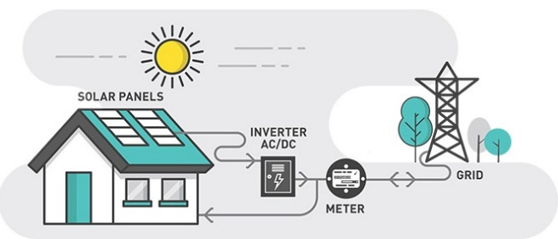
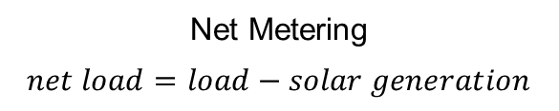
Estimation of BTM Solar Generation
Residential solar PV adoptions are increasing rapidly around the world.
Most residential solar PV systems are deployed behind the smart meters installed by the electric utilities.
Hence, the utilities typically only collect the net load data.
However, an accurate estimation of solar PV generation is crucial to an array of distribution system planning and operation activities.
  Hosting capacity analysis
  Feeder/substation net load forecasting
  Load transfer and Volt-VAR control
Net Metering
$$net load=load−solar generation$$

Slide 42
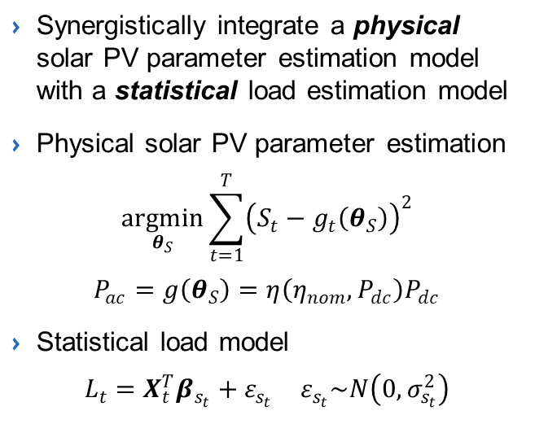
Estimate BTM Solar Generation: A single customer
Disaggregation Method
Net load time series data
Physical
model
Synergistically integrate a physical solar PV parameter estimation model with a statistical load estimation model
Physical solar PV parameter estimation
$$\underset{θ_{S}}{argmin}{\sum_{t=1}^{T}{{\left(S_{t}−g_{t}\left(θ_{S}\right)\right)}^{2}}}$$
$$P_{ac}=g\left(θ_{S}\right)=η\left(η_{nom},P_{dc}\right)P_{dc}$$
Statistical load model
$$\begin{matrix}L_{t}=X_{t}^{T}β_{s_{t}}+ε_{s_{t}} ε_{s_{t}}\sim N\left(0,σ_{s_{t}}^{2}\right) \\ \end{matrix}$$
Estimation of solar PV parameters and solar generation
Statistical
model
Load Estimation
Stopping criteria
no
yes
Disaggregated signals
Post Disaggregation adjustment
Final disaggregated signals
Error Metric | Variable | HMM reg. model | Consumer Mixture Model | SunDance Model
MSE | Load | 0.2114 | 0.3786 | 0.4866
 | Solar | 0.2328 | 0.4269 | 0.5409
MASE | Load | 0.5051 | 0.7374 | 0.8089
 | Solar | 2.7440 | 3.9133 | 3.7409
Farzana Kabir, Nanpeng Yu, Weixin Yao, Rui Yang and Yingchen Zhang, "Estimation of Behind-the-Meter Solar Generation by Integrating Physical with Statistical Models," IEEE SmartGridComm, pp.1-5, 2019.

Slide 43
Estimate BTM Solar Generation in a Community
The electric load for a group of customers are estimated jointly by a mixed hidden Markov model (MHMM)
  Enables modeling the general load consumption behavior present in all customers while acknowledging the individual differences.
  Allows the sharing of information across individual customers, which leads to more accurate load and solar PV generation estimates.
MHMM with customer-specific random intercepts
Comparison of disaggregated load and solar PV generation (customer in Austin Texas)
Farzana Kabir, Nanpeng Yu, Weixin Yao, Rui Yang, and Yingchen Zhang, "Joint Estimation of Behind-the-Meter Solar Generation in a Community," IEEE Transactions on Sustainable Energy, vol. 12, no. 1, pp. 682-694, Jan. 2021,

Slide 44
Outline
Applications of Machine Learning in Smart Grid
  Transmission System and Electricity Market
  Distribution System and End-use Customer
Key Problems Solved by Pure Data-Driven Methods
  Power System Event Detection and Classification Using PMU Data
  Deep Reinforcement Learning-based Distribution System Control
Key Problems Solved by Physics-Informed Methods
  Phase Connectivity Identification, Theft Detection
  Line Parameter Estimation
  Behind-the-meter Solar PV Generation Estimation
Important Takeaway

Slide 45
Important Takeaway
Work with Real-world Data
  Simulation data does not possess the same property as real-world data
  Most algorithms developed with simulation data fail to solve real-world problems
Collaboration with Electric Utilities
  Learn about current practice and realistic challenges
  Work on solutions that could address real-world problems
The Need to Synergistically Combine ML with Physical Domain Knowledge
  Physics of power system operations (e.g., power flow, system dynamics, solar generation)
  Topology of power network (e.g., graph signal processing, graph learning)
  Statistical properties of data generated from physical system
    Low rank properties and sparsity patterns (e.g., PMU data, smart meter data)
    Entropy of dataset (e.g., smart meter voltage magnitude → low entropy, PMU data → high entropy)
    Spatial temporal correlations (e.g., SCADA data for distribution feeders, PMU data)

Slide 46
Questions?
Contact Information
  Dr. Nanpeng Yu
  Director of Energy, Economics, and Environment Research Center
  Department of Electrical and Computer Engineering
  Department of Computer Science
  University of California Riverside
  Email: nyu@ece.ucr.edu
  Website: http://www.ece.ucr.edu/~nyu/

