Slide 1
Machine Learning and Big Data Analytics in Power Distribution Systems
Dr. Nanpeng Yu
Department of Electrical and Computer Engineering
Department of Computer Science
(cooperating faculty)
nyu@ece.ucr.edu
951.827.3688

Slide 2








Team Members and Research Sponsors
  Principal Investigator
    Dr. Nanpeng Yu
  Ph.D. Students
    Brandon Foggo (B.S. UCLA), Wei Wang (M.S. University of Michigan)
    Yuanqi Gao (B.S. UCR), Wenyu Wang (M.S. Iowa State University)
    Jie Shi (M.S. Southeast University), Farzana Kabir (B.S. BUET)
    Yinglun Li (M.S. UCR)
  Research Sponsors and Collaborating Organizations

Slide 3

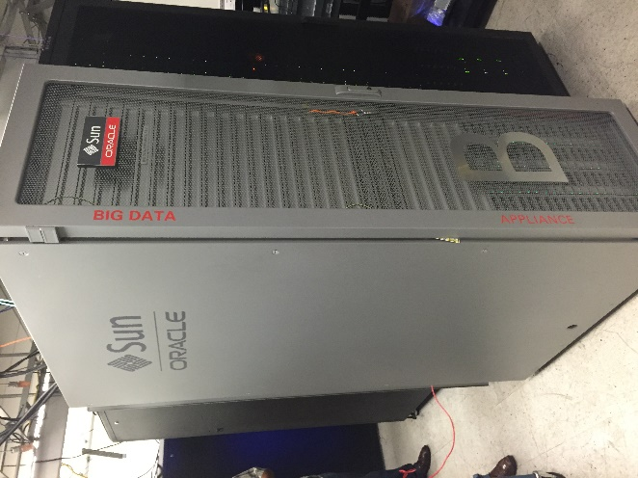
Computing Facilities
  Deep Learning Workstation
    4 x NVIDIA RTX 2080
    4 x 16 GB Memory
    512 GB SSD (OS)
    2 x 2TB HDD (Data)
  Oracle Big Data Appliance
    Number of Nodes: 6
    Number of Core: 216
    Hard Drive: 288 TB of 7,200 rpm High Capacity SAS Disks
    Memory: 768 GB DDR4
    Hadoop Platform: CDH Enterprise Edition
    Tools: Hive, Pig, Impala, PySpark, Scala, TensorFlow

Slide 4
Outline
Why do we focus on electric power distribution systems?
Big data in power distribution systems
  Volume, Variety, Velocity, and Value
Machine learning and big data applications in distribution systems
  Topology Identification: Phase Connectivity Identification
  Unsupervised Machine Learning
    Linear Dimension Reduction & Centroid-based Clustering
    Nonlinear Dimension Reduction & Density-based Clustering
    Physically Inspired Maximum Marginal Likelihood Estimation
https://intra.ece.ucr.edu/~nyu/Teaching/2019-03-28-IEEE-Big-Data-Seminar

Slide 5
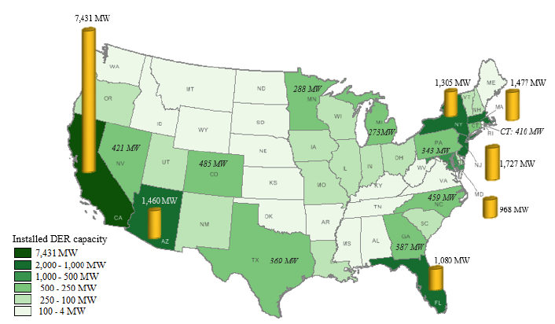
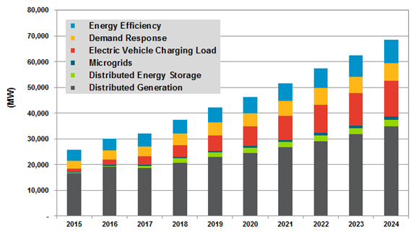
Why focus on distribution systems?
Increasing penetrations of distributed energy resource (DER) in power distribution systems
  On a 5-year basis (2015-2019), DER in US is growing almost 3 times faster than central generation (168 GW vs. 57 GW).
  In 2016, distributed solar PV installations alone represented 12% of new capacity additions.
  California DER, 7GW in 2017, 12 GW by 2020 (peak load 50 GW)
U.S. DER Deployments
Annual Installed DER Power Capacity Additions by DER Technology, United States: 2015-2024
Source: The U.S. EIA and FERC DER Staff Report
Source: Navigant Report, Take Control of Your Future

Slide 6

The need for advanced modeling, monitoring, and control in distribution systems
The cold hard facts about modern power distribution systems
  Modeling
    Incomplete topology information in the secondary systems
      Phase connection
      Transformer-to-customer mapping
    Even the three-phase load flow results are unreliable!
  Monitoring
    Most utilities do not have online three-phase state estimation for their entire distribution network
  Control
    Reactive Control
      System restoration, equipment maintenance
    Limited Proactive Control
      Volt-VAR control, CVR, network reconfiguration

Slide 7
Outline
Why do we focus on electric power distribution systems?
Big data in power distribution systems
  Volume, Variety, Velocity, and Value
Machine learning and big data applications in distribution systems
  Topology Identification: Phase Connectivity Identification
  Unsupervised Machine Learning
    Linear Dimension Reduction & Centroid-based Clustering
    Nonlinear Dimension Reduction & Density-based Clustering
    Physically Inspired Maximum Marginal Likelihood Estimation

Slide 8
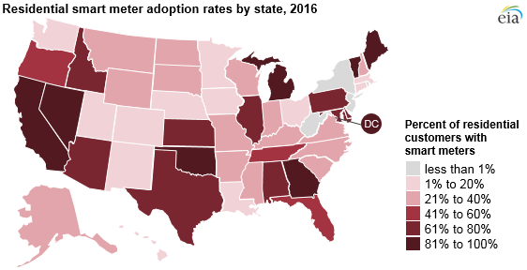
Big Data in Distribution Systems: Volume
In 2017, the U.S. electric utilities had about 78.9 million AMI installations covering over 50% of 150 million electricity customers.
The smart meter installation worldwide will surpass 1.1 billion by 2022.
In 2012, the AMI data collected in the U.S. alone amounted to well above 100 terabytes.
By 2022, the electric utility industry will be swamped by more than 2 petabytes of meter data alone.
U.S. Smart Meter Installations Projected to Reach 90 Million by 2020
Source: U.S. Energy Information Administration
Source: Institute for Electric Innovation

Slide 9

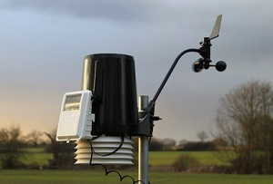


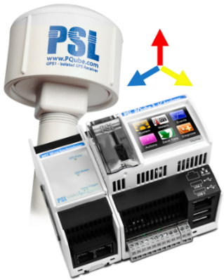
Big Data in Distribution Systems: Variety
Advanced Metering Infrastructure
  Electricity usage (15-minute, hourly)
  Voltage magnitude
Weather Station
Geographical Information System
Census Data (block group level)
  Household variables: ownership, appliance, # of rooms
  Person variables: age, sex, race, income, education
SCADA Information
Micro-PMU
  Time synchronized measurements with phase angles
Equipment Monitors

Slide 10
Big Data in Distribution Systems: Velocity
Sampling Frequency
  AMI’s data recording frequency increases from once a month to one reading every 15 minutes to one hour.
  Micro-PMU hundreds (512) of samples per cycle at 50/60 Hz
Bottleneck in Communication Systems
  Limited bandwidth for zigbee network
  Most of the utilities in the US receives smart meter data with ~24 hour delay
Edge Computing Trend
  Itron and Landis+Gyr extend edge computing capability of smart meters
  Increasing data transmission range and computing capabilities of smart meters
  Centralized → distributed / decentralized

Slide 11
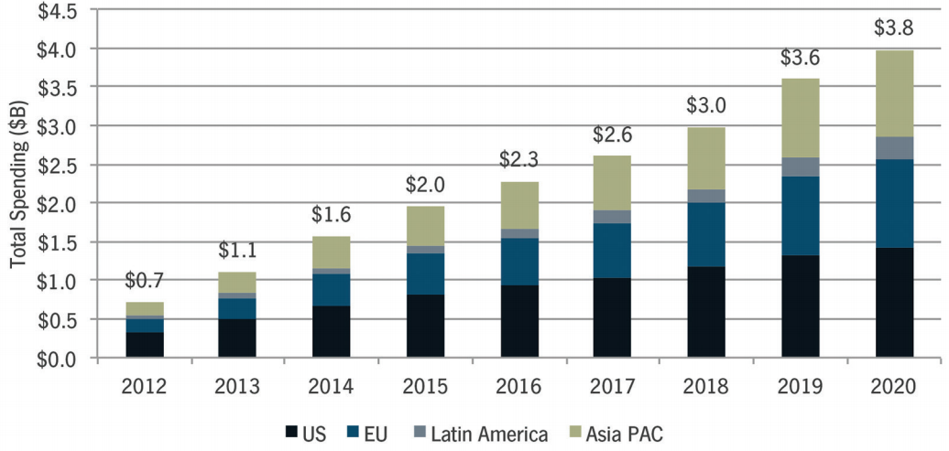
Big Data in Distribution Systems: Value
The big data collected in the power distribution system had utterly swamped the traditional software tools used for processing them.
Lack of innovative use cases and applications to unleash the full value of the big data sets in power distribution systems¹.
Insufficient research on machine learning and big data analytics for power distribution systems.
Electric utilities around the world will spend over $3.8 billion on data analytics solutions in 2020.
Source: GTM Research
  1. Nanpeng Yu, Sunil Shah, Raymond Johnson, Robert Sherick, Mingguo Hong and Kenneth Loparo, “Big Data Analytics in Power Distribution Systems” IEEE PES ISGT, Washington DC, Feb. 2015.

Slide 12
Outline
Why do we focus on electric power distribution systems?
Big data in power distribution systems
  Volume, Variety, Velocity, and Value
Machine learning and big data applications in distribution systems
  Topology Identification: Phase Connectivity Identification
  Unsupervised Machine Learning
    Linear Dimension Reduction & Centroid-based Clustering
    Nonlinear Dimension Reduction & Density-based Clustering
    Physically Inspired Maximum Marginal Likelihood Estimation

Slide 13

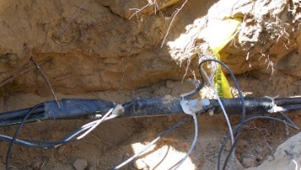
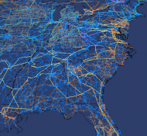

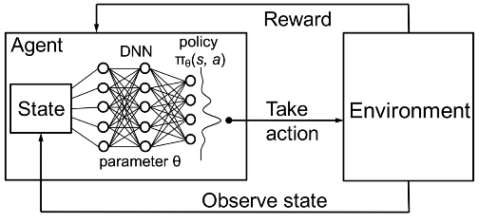
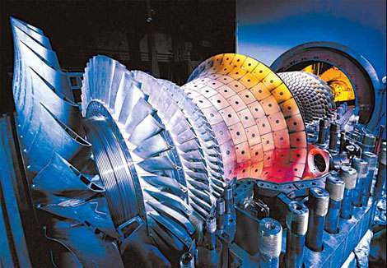

Applications of Big Data Analytics and Machine Learning in Power Distribution Systems
Spatio-temporal Forecasting
Electric Load / DERs – Short-Term / Long-Term
Anomaly Detection
Electricity Theft, Unauthorized Solar Interconnection
System Monitoring
State Estimation & Visualization
Distribution System Controls
Deep Reinforcement Learning
Network Topology and Parameter Identification
Transformer-to-customer, Phase connectivity, Impedance estimation
Equipment Monitoring
Predictive Maintenance
Online Diagnosis
Customer Behavior Analysis
Customer segmentation, nonintrusive load monitoring, demand response

Slide 14
Publications: Big Data Analytics & Machine Learning in Smart Grid
  1. N. Yu, S. Shah, R. Johnson, R. Sherick, Mingguo Hong and Kenneth Loparo, "Big Data Analytics in Power Distribution Systems", IEEE PES Conference on Intelligent Smart Grid Technology, Washington DC, Feb. 2015.
  2. Xiaoyang Zhou, Nanpeng Yu, Weixin Yao and Raymond Johnson, “Forecast load impact from demand response resources” Power and Energy Society General Meeting, pp. 1-5, Boston, USA, 2016.
  3. W. Wang, N. Yu, B. Foggo, and J. Davis, “Phase identification in electric power distribution systems by clustering of smart meter data” 15th IEEE International Conference on Machine Learning and Applications (ICMLA), pp. 1-7, Anaheim, CA, 2016.
  4. Jie Shi and Nanpeng Yu, “Spatio-temporal modeling of electric loads” in 49th North American Power Symposium, pp.1-6, Morgantown, WV, 2017.
  5. W. Wang, N. Yu, and R. Johnson “A model for commercial adoption of photovoltaic systems in California” Journal of Renewable and Sustainable Energy, Vol. 9, Issue, 2, pp.1-15, 2017.
  6. Yuanqi Gao and Nanpeng Yu, “State estimation for unbalanced electric power distribution systems using AMI data” The Eighth Conference on Innovative Smart Grid Technologies (ISGT 2017), pp. 1-5, Arlington, VA.
  7. Wenyu. Wang and Nanpeng Yu, "AMI Data Driven Phase Identification in Smart Grid," the Second International Conference on Green Communications, Computing and Technologies, pp. 1-8, Rome, Italy, Sep. 2017.
  8. Jinhui Yang, Nanpeng Yu, Weixin Yao, Alec Wong, Larry Juang, and Raymond Johnson, “Evaluate the effectiveness of CVR with robust regression” in Probabilistic Methods Applied to Power Systems, pp.1-6, 2018.
  9. Brandon Foggo, Nanpeng Yu, “A comprehensive evaluation of supervised machine learning for the phase identification problem”, the 20th International Conference on Machine Learning and Applications, pp.1-9, Copenhagen, Denmark, 2018.
  10. Ke Wang, Haiwang Zhong, Nanpeng Yu, and Qing Xia, “Nonintrusive load monitoring based on sequence-to-sequence model with attention mechanism”, Proceedings of the CSEE, 2018.
  11. Farzana Kabir, Brandon Foggo, and Nanpeng Yu, "Data Driven Predictive Maintenance of Distribution Transformers," in the 8th China International Conference on Electricity Distribution, pp. 1-5 2018.
  12. Wei Wang and Nanpeng Yu, " A Machine Learning Framework for Algorithmic Trading with Virtual Bids in Electricity Markets," to appear in IEEE Power and Energy Society General Meeting, 2019.
  13. Yuanqi Gao, Brandon Foggo, and Nanpeng Yu, “A physically inspired data-driven model for electricity theft detection with smart meter data” to appear in IEEE Transactions on Industrial Informatics, 2019.
  14. Wang, Wenyu, and Nanpeng Yu. "Maximum Marginal Likelihood Estimation of Phase Connections in Power Distribution Systems." arXiv preprint arXiv:1902.09686 (2019).
https://intra.ece.ucr.edu/~nyu/

Slide 15
Outline
Why do we focus on electric power distribution systems?
Big data in power distribution systems
  Volume, Variety, Velocity, and Value
Machine learning and big data applications in distribution systems
  Topology Identification: Phase Connectivity Identification
  Unsupervised Machine Learning
    Linear Dimension Reduction & Centroid-based Clustering
    Nonlinear Dimension Reduction & Density-based Clustering
    Physically Inspired Maximum Marginal Likelihood Estimation

Slide 16
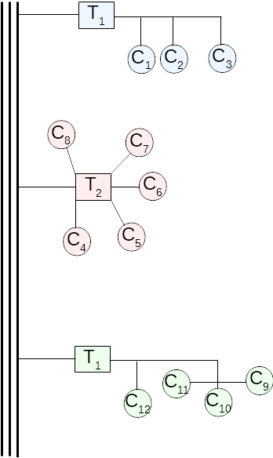
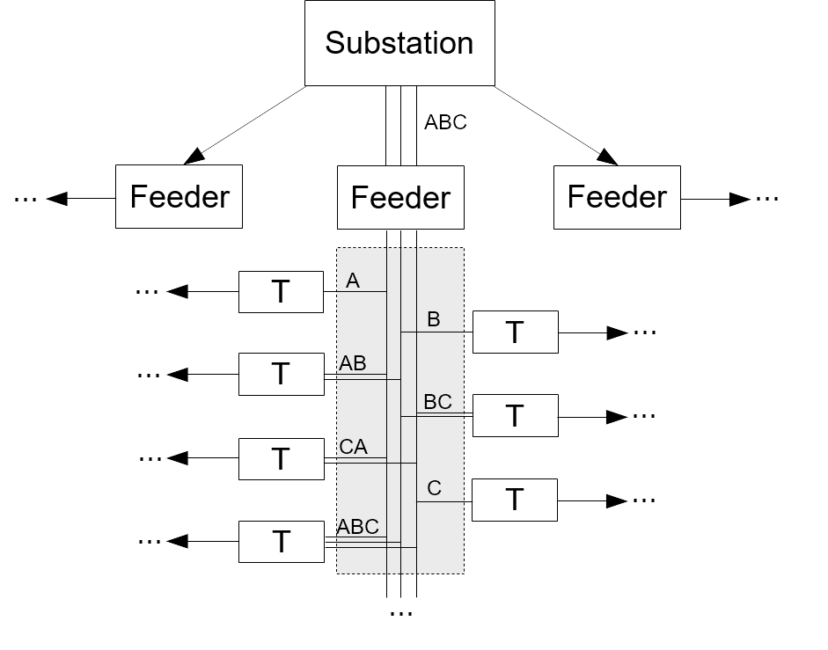
Distribution System Topology Identification
The distribution system topology identification problem can be broken down into two sub-problems
  The phase connectivity identification problem
  The customer to transformer association problem

Slide 17
Phase Connectivity Identification
Problem Definition
  Identify the phase connectivity of each customer & structure in the power distribution network.
  Very few electric utility companies have completely accurate phase connectivity information in GIS!
Why is it important? (Business Value)
  Phase connectivity is crucial to an array of distribution system analysis & operation tools including
    3-phase Power flow
    Load balancing
    Distribution network state estimation
    3-phase optimal power flow
    Volt-VAR control
    Distribution network reconfiguration and restoration

Slide 18

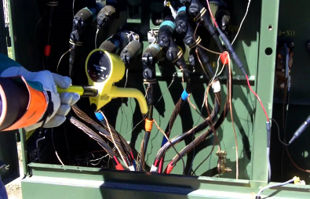
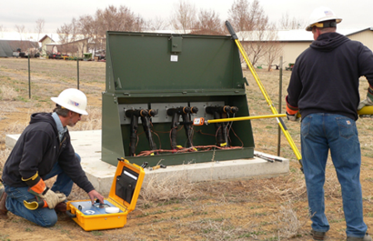
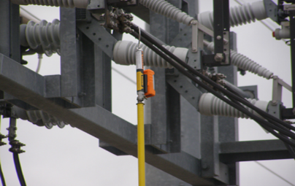
Phase Connectivity Identification
Primary Data Set
  Advanced Metering Infrastructure, SCADA, GIS, OMS
  Training data (field validated phase connectivity)
Solution Methods
  Physical approach with Special Sensors
    Micro-synchrophasors, Phase Meters
    Drawback: expensive equipment, labor intensive ($2,000 per feeder), 3,000 feeders for a regional electric utility company ($6 million)

Slide 19

Phase Connectivity Identification
Solution Methods
  Integer Optimization, Regression and Correlation based Approach
    0-1 integer linear programming (IBM)
    Correlation/Regression based methods (EPRI)
    Drawback: cannot handle delta connected Secondaries, low tolerance for erroneous or missing data, low accuracy and high computational cost
  Data-driven phase identification technology
    Synergistically combine machine learning techniques and physical understanding of electric power distribution networks.
    Unsupervised and supervised machine learning algorithms
    High accuracy on all types of distribution circuits. (overhead, underground, phase-to-neutral, phase-to-phase, pilot demonstration on over 100 distribution feeders)

Slide 20
Outline
Why do we focus on electric power distribution systems?
Big data in power distribution systems
  Volume, Variety, Velocity, and Value
Machine learning and big data applications in distribution systems
  Topology Identification: Phase Connectivity Identification
  Unsupervised Machine Learning
    Linear Dimension Reduction & Centroid-based Clustering
    Nonlinear Dimension Reduction & Density-based Clustering
    Physically Inspired Maximum Marginal Likelihood Estimation

Slide 21
Unsupervised Machine Learning Algorithm¹
General Framework
Step 3: Gather Distribution Network Connectivity Information
Step 4: Generate Must-link Constraints
Step 2: Normalize Time Series Data, Impute Missing Values, and Perform Dimension Reduction
Step 5: Perform Centroid-based Clustering to Group Customers/Smart Meters
Step 1: Collect Voltage Data from Smart Meters and SCADA System
Step 6: Identify the Phase Connectivity of Each Cluster
  1. W. Wang, N. Yu, B. Foggo, and J. Davis, “Phase identification in electric power distribution systems by clustering of smart meter data” 15th IEEE International Conference on Machine Learning and Applications (ICMLA), pp. 1-7, Anaheim, CA, 2016.

Slide 22
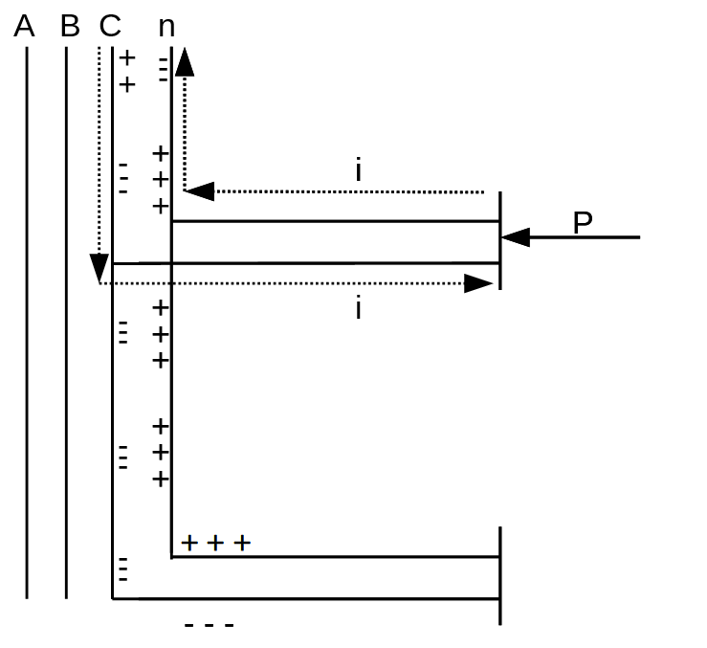
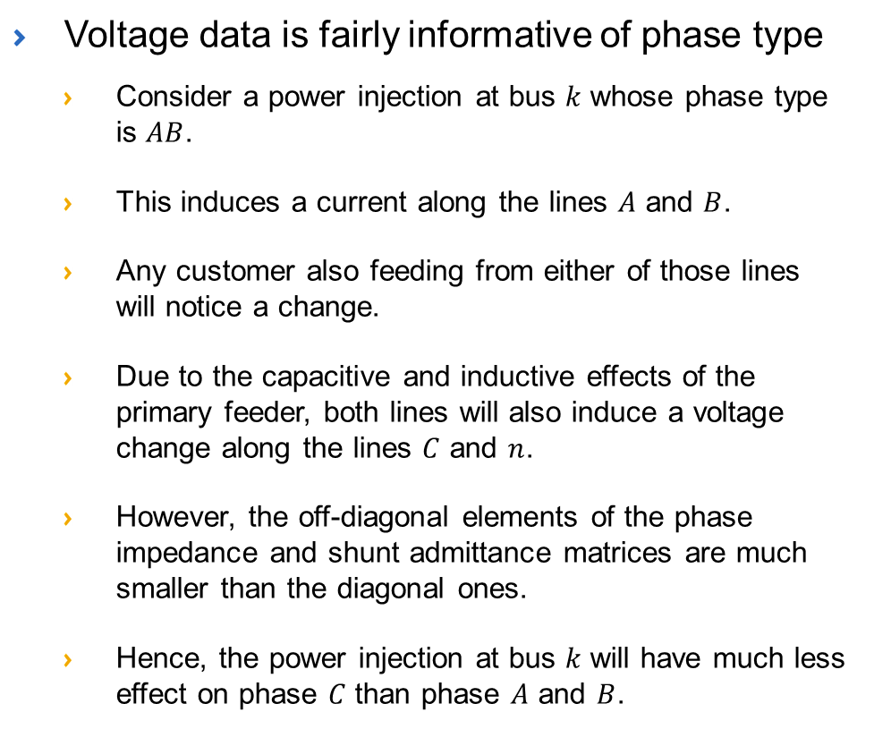
Why Voltage Data Is Predictive of Phase?
Voltage data is fairly informative of phase type
  Consider a power injection at bus $k$ whose phase type is $AB$.
  This induces a current along the lines $A$ and $B$.
  Any customer also feeding from either of those lines will notice a change.
  Due to the capacitive and inductive effects of the primary feeder, both lines will also induce a voltage change along the lines $C$ and $n$.
  However, the off-diagonal elements of the phase impedance and shunt admittance matrices are much smaller than the diagonal ones.
  Hence, the power injection at bus $k$ will have much less effect on phase $C$ than phase $A$ and $B$.

Slide 23
Must-link Constraints
Customers connected to the same secondary must have the same phase connections

Slide 24
Case Study: Southern California Edison Distribution Circuit
Voltage Level | 12.47 kV
Peak load | ~5 MW
Number of Customers | ~1500
Customer type | 95% residential
Most of the customers served by a three-wire single-phase system through center-tapped transformers (120/240 V).
Highly unbalanced in terms of phase currents.
6 month of smart meter data and SCADA data.
Engineers gather actual phase connectivity of each building and structure through field validation.

Slide 25
Unsupervised Learning: Unconstrained Clustering
Phase Identification Accuracy: 92.89%
Cluster number | Number of customers | Accuracy (%) | Phase
1 | 226 | 94.25 | CA
2 | 647 | 95.21 | AB
3 | 364 | 87.91 | BC
The circuit is highly unbalanced and has 3 possible phase connections.
Even linear dimension reduction technique results in reasonable separation among customers with different phase connections.

Slide 26
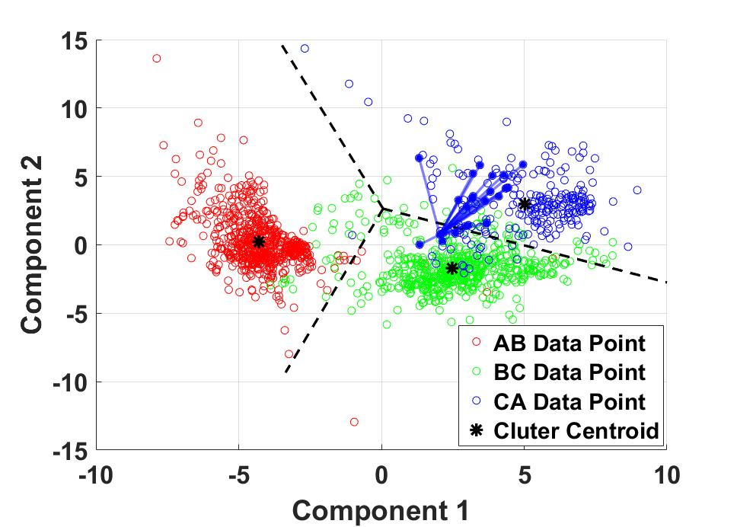
Supervised Learning: Constrained Clustering
Phase Identification Accuracy: 96.69%
Cluster number | Number of customers | Accuracy (%) | Phase
1 | 618 | 99.84 | AB
2 | 384 | 91.41 | BC
3 | 235 | 97.02 | CA
The must-link constraints pulled some of the blue points (customers with phase connections of CA) in the green region back to the blue area.
The must-link constraints improve the phase identification accuracy.

Slide 27
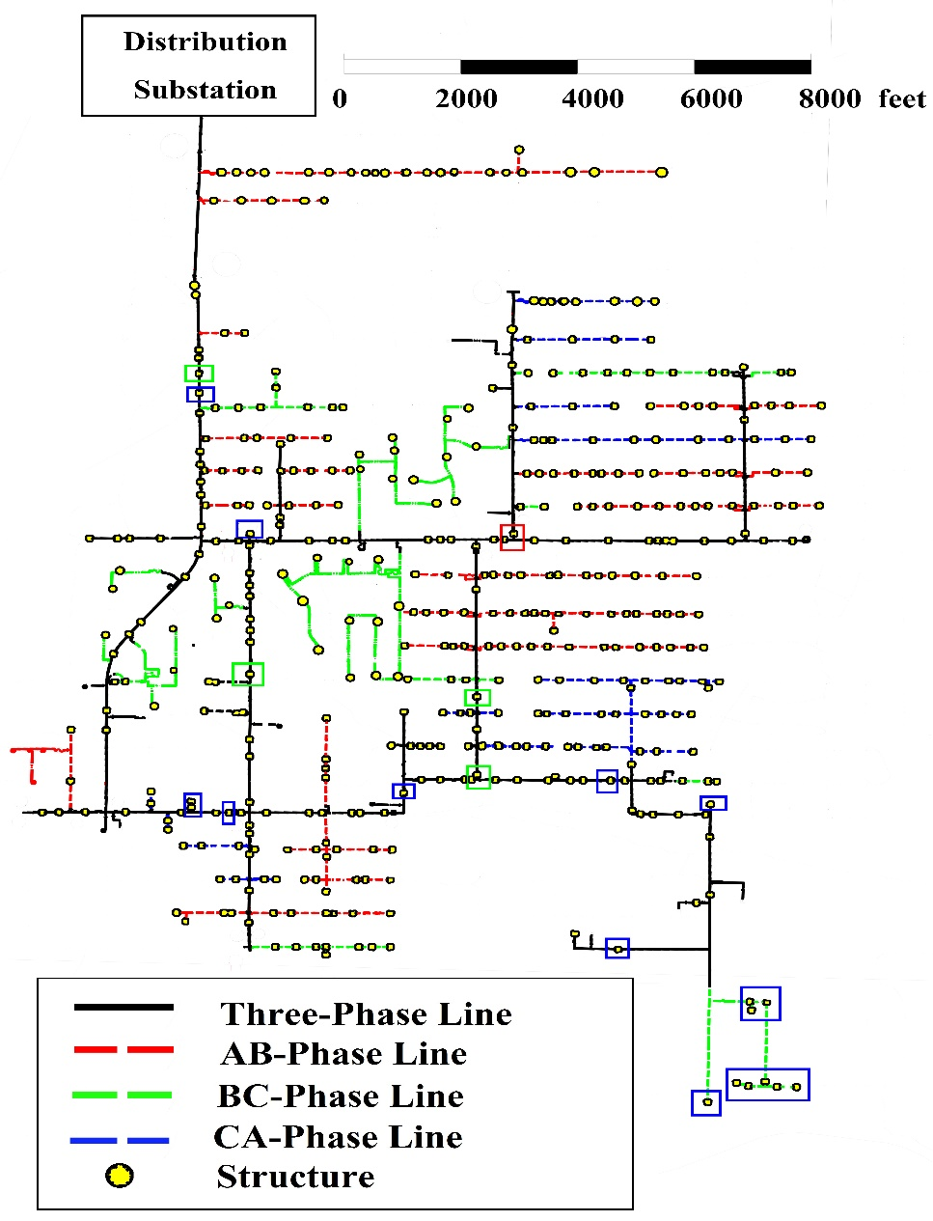
Visualization of Phase Identification Accuracy
With GIS inputs, visualization of distribution circuit with phase connection information can be generated automatically
  Each line is colored according to its actual phase
  Each structure is represented by a small dot
  A colored rectangle is overlaid on top of a structure if it is assigned to the wrong cluster.

Slide 28
Outline
Why do we focus on electric power distribution systems?
Big data in power distribution systems
  Volume, Variety, Velocity, and Value
Machine learning and big data applications in distribution systems
  Topology Identification: Phase Connectivity Identification
  Unsupervised Machine Learning
    Linear Dimension Reduction & Centroid-based Clustering
    Nonlinear Dimension Reduction & Density-based Clustering
    Physically Inspired Maximum Marginal Likelihood Estimation

Slide 29
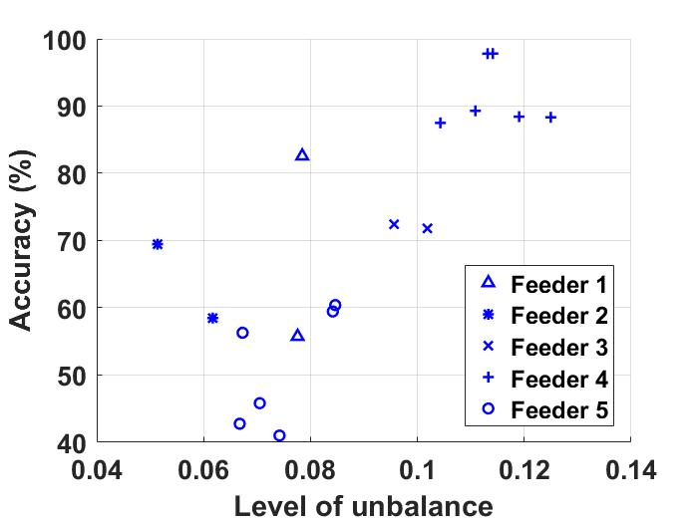
Drawbacks of Constrained K-means Clustering Algorithm (CK-Means)
First, all of the prior proposed methods assume that the number of phase connections are known.
  E.g., in the CK-Means algorithm, the number of phase connections/clusters needs to be know as prior knowledge
Second, the existing methods can not provide accurate phase identiﬁcation results when there is a mix of phase-to-neutral and phase-to-phase connected smart meters and structures.
  The phase identification accuracy decreases as the number of possible phase connection increases.
Third, the existing methods are quite sensitive to the level of unbalance in a distribution feeder.
  The phase identification accuracy decrease as the level of unbalance decreases.

Slide 30
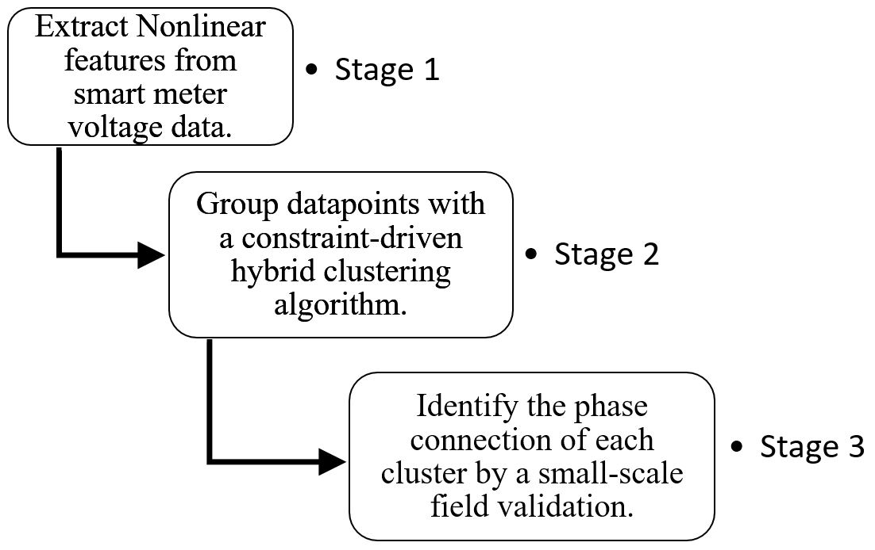
Nonlinear Dimension Reduction & Density-based Clustering²
General Framework
  2. W. Wang and N. Yu, "AMI Data Driven Phase Identification in Smart Grid," the Second International Conference on Green Communications, Computing and Technologies, pp. 1-8, Rome, Italy, Sep. 2017.

Slide 31
Stage 1 Feature Extraction from Voltage Time Series
Dimension reduction techniques
  Linear dimension reduction techniques (E.g., PCA)
    Drawbacks
      Restricted to learning only linear manifolds. High-dimensional data lies on or near a low-dimensional, non-linear manifold.
      Difﬁcult for linear mappings to keep the low-dimensional representations of very similar points close together.
    Explains the lower accuracy of phase identiﬁcation algorithm using linear features for less unbalanced feeders.
  Nonlinear dimensionality reduction techniques
    Sammon mapping, curvilinear components analysis (CCA), Isomap, and t-distributed stochastic neighbor embedding (t-SNE).
    We adopt t-SNE, because it has been shown to work well with a wide range of data sets and captures both local and global data structures.
    t-SNE improves upon SNE by
    Simplifying the gradient calculation with a symmetrized version of the SNE cost function
    Adopting a Student-t distribution rather than a Gaussian to compute the similarity between two points in the low-dimensional space

Slide 32
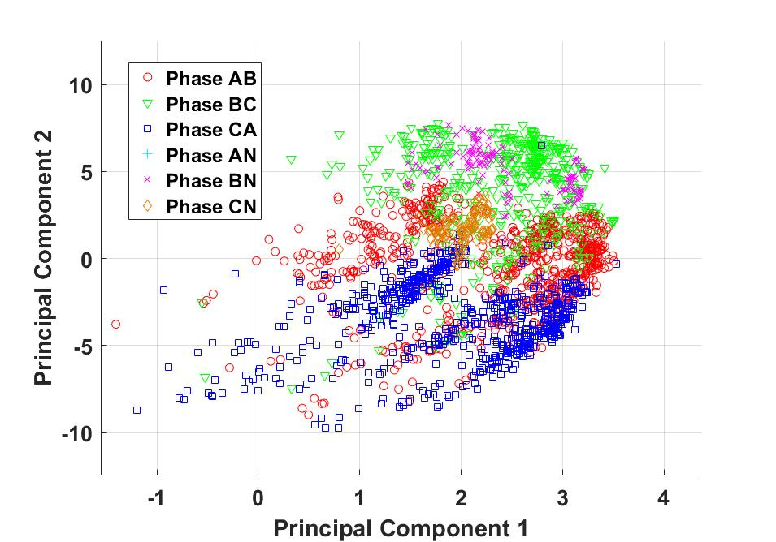
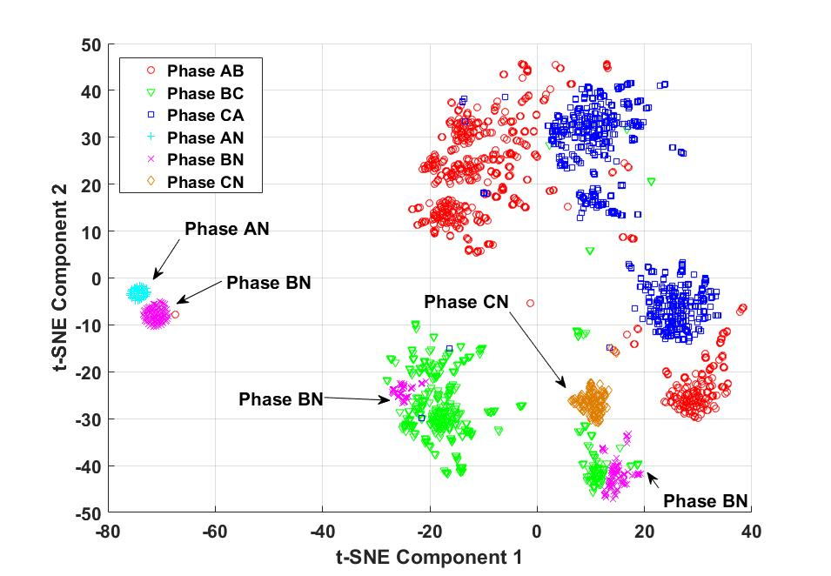
Comparison between PCA & t-SNE
Feeder 5, data set 18 with a low level of unbalance
The data points are not well separated according to phase connection with linear dimension reduction.
The non-linear dimensionality reduction technique does a much better job in extracting hidden features from the voltage time series during a less unbalanced period for the feeders.

Slide 33
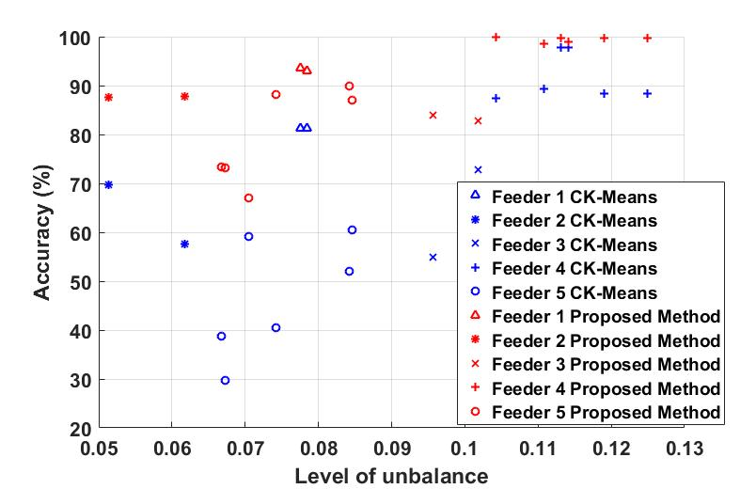
Phase Identiﬁcation Accuracy with CK-Means and the Proposed Method
The proposed phase identiﬁcation algorithm signiﬁcantly outperforms the CK-Means method with all data sets in terms of accuracy.
On average, the proposed phase identiﬁcation algorithm improves the identiﬁcation accuracy by 19.81% over the CK-Means algorithm.

Slide 34
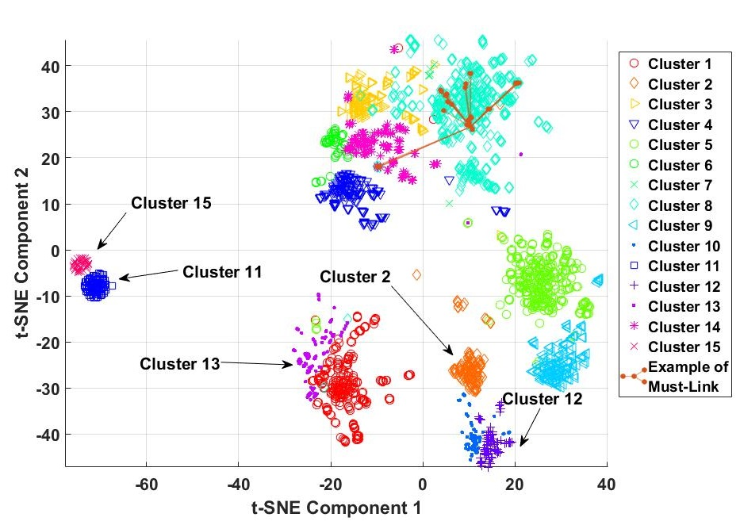
Clustering Results of the Proposed Method
Nonconvex clusters are identified.
The proposed phase identiﬁcation algorithm not only groups phase-to-phase meters for phase AB, BC, and CA accurately, but also groups single-phase meters with high accuracy

Slide 35
Impact of Data Granularity on Accuracy
Feeder | Data Set | Granularity of Meter Readings
 |  | 1 hour | 15-minute | 5-minute
1 | s1 | 93.06% | 93.93% | 93.88%
 | s2 | 93.62% | 94.32% | 94.40%
2 | s3 | 87.55% | 88.86% | 92.03%
 | s4 | 87.79% | 90.47% | 89.93%
3 | s5 | 83.94% | 90.02% | 91.56%
 | s6 | 82.83% | 84.51% | 87.16%
As the granularity of meter readings increases from hourly to every 15 minutes and then 5 minutes, the phase identiﬁcation accuracy increases.
The average increase in phase identiﬁcation accuracy over the 3 distribution circuits is 3.36% when the meter reading granularity increases from hourly to 5 minutes.
More granular voltage readings allows extraction of features/patterns that may not be present in coarse data sets

Slide 36
Outline
Why do we focus on electric power distribution systems?
Big data in power distribution systems
  Volume, Variety, Velocity, and Value
Machine learning and big data applications in distribution systems
  Topology Identification: Phase Connectivity Identification
  Unsupervised Machine Learning
    Linear Dimension Reduction & Centroid-based Clustering
    Nonlinear Dimension Reduction & Density-based Clustering
    Physically Inspired Maximum Marginal Likelihood Estimation

Slide 37
Motivation and Main Idea³
Motivation
  Existing data-driven approaches lack physical interpretation and theoretical guarantee.
  Their performance generally deteriorates as the complexity of the network, the number of phase connections, and the level of load balanceness increase.
  Need a physically inspired data-driven algorithm for phase identification.
Overall Framework
  Develop a physical model, which links the phase connections to the voltage magnitudes and power injections via the three-phase power flow manifold.
  Formulate the phase identification problem as a maximum likelihood estimation (MLE) and a maximum marginal likelihood estimation (MMLE) problem.
  Prove that the correct phase connection solution achieves the highest log likelihood values for both problems.
  Develop an efficient solution algorithm for the MMLE problem.
  3. Wang, Wenyu, and Nanpeng Yu. "Maximum Marginal Likelihood Estimation of Phase Connections in Power Distribution Systems." arXiv preprint arXiv:1902.09686 (2019).

Slide 38
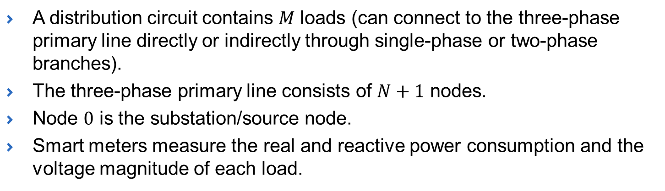
Problem Setup
A distribution circuit contains $M$ loads (can connect to the three-phase primary line directly or indirectly through single-phase or two-phase branches).
The three-phase primary line consists of $N+1$ nodes.
Node $0$ is the substation/source node.
Smart meters measure the real and reactive power consumption and the voltage magnitude of each load.

Slide 39
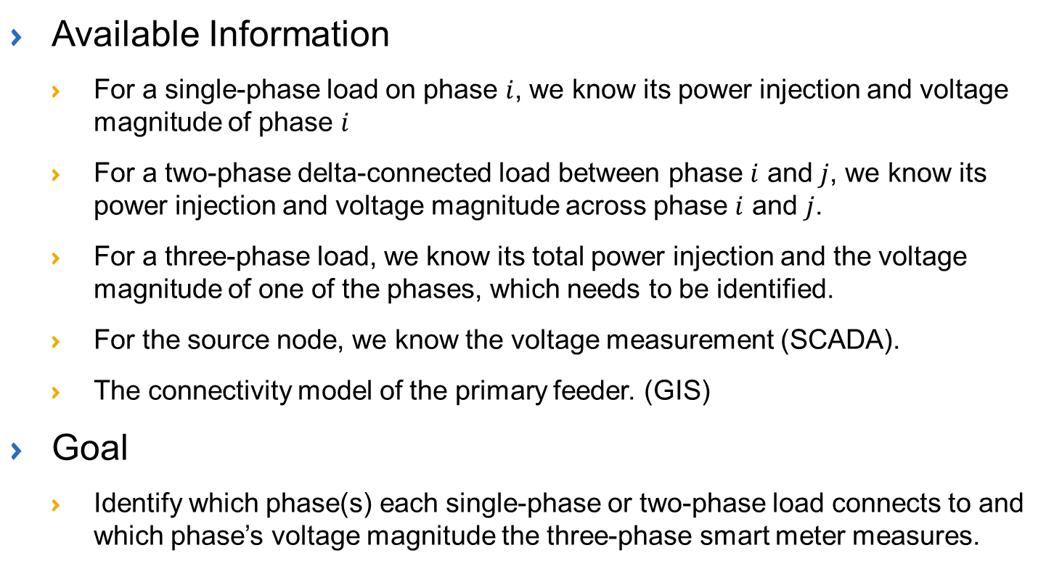
Available Information and Goal
Available Information
  For a single-phase load on phase $i$, we know its power injection and voltage magnitude of phase $i$
  For a two-phase delta-connected load between phase $i$ and $j$, we know its power injection and voltage magnitude across phase $i$ and $j$.
  For a three-phase load, we know its total power injection and the voltage magnitude of one of the phases, which needs to be identified.
  For the source node, we know the voltage measurement (SCADA).
  The connectivity model of the primary feeder. (GIS)
Goal
  Identify which phase(s) each single-phase or two-phase load connects to and which phase’s voltage magnitude the three-phase smart meter measures.

Slide 40
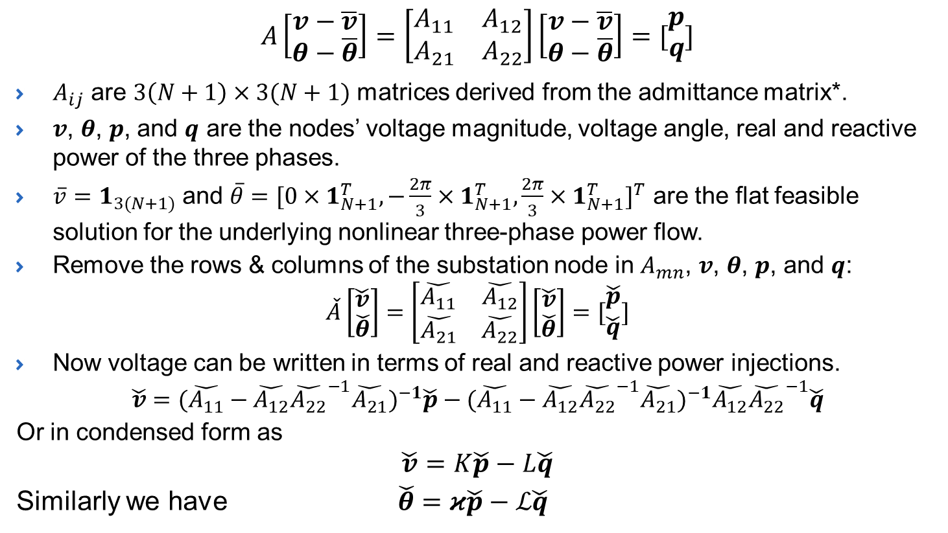
Linearized Three-phase Power Flow Model
$$A\left[\begin{matrix}v−\overline{v} \\ θ−\overline{θ}\end{matrix}\right]=\left[\begin{matrix}A_{11} & A_{12} \\ A_{21} & A_{22}\end{matrix}\right]\left[\begin{matrix}v−\overline{v} \\ θ−\overline{θ}\end{matrix}\right]=[\begin{matrix}p \\ q\end{matrix}]$$
$A_{ij}$ are $3\left(N+1\right)×3(N+1)$ matrices derived from the admittance matrix*.
$v$, $θ$, $p$, and $q$ are the nodes’ voltage magnitude, voltage angle, real and reactive power of the three phases.
$\overline{v}=1_{3(N+1)}$ and $\overline{θ}={[0×1_{N+1}^{T}, −\frac{2π}{3}×1_{N+1}^{T},\frac{2π}{3}×1_{N+1}^{T}]}^{T}$ are the flat feasible solution for the underlying nonlinear three-phase power flow.
Remove the rows & columns of the substation node in $A_{mn}$, $v$, $θ$, $p$, and $q$:
$$\check{A}\left[\begin{matrix}\check{v} \\ \check{θ}\end{matrix}\right]=\left[\begin{matrix}\check{A_{11}} & \check{A_{12}} \\ \check{A_{21}} & \check{A_{22}}\end{matrix}\right]\left[\begin{matrix}\check{v} \\ \check{θ}\end{matrix}\right]=[\begin{matrix}\check{p} \\ \check{q}\end{matrix}]$$
Now voltage can be written in terms of real and reactive power injections.
$$\check{v}={(\check{A_{11}}−\check{A_{12}}{\check{A_{22}}}^{−1}\check{A_{21}})}^{−1}\check{p}−{(\check{A_{11}}−\check{A_{12}}{\check{A_{22}}}^{−1}\check{A_{21}})}^{−1}\check{A_{12}}{\check{A_{22}}}^{−1}\check{q}$$
Or in condensed form as
$$\check{v}=K\check{p}−L\check{q}$$
Similarly we have $\check{θ}=κ\check{p}−ℒ\check{q}$
*$rank(A)$ is at most $6N$. Need to transform $A$ into a nonsingular form to make the subsequent derivations easier.

Slide 41
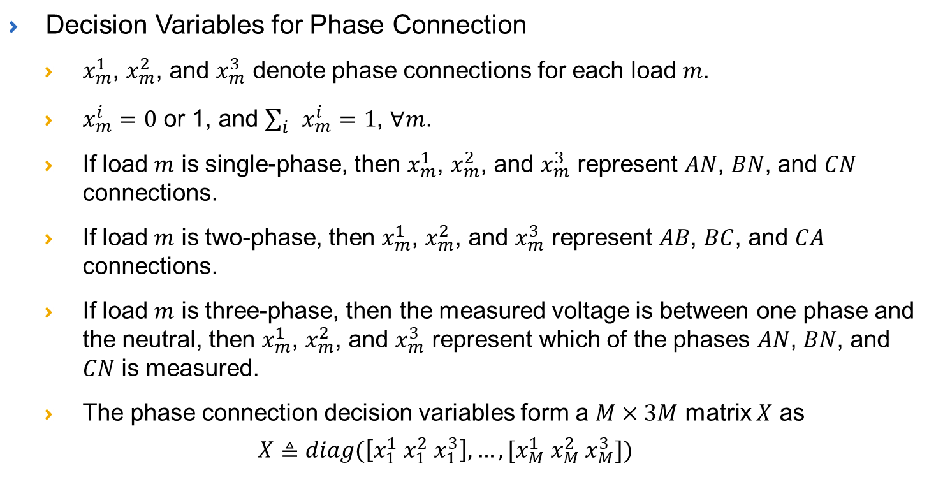
Modeling Phase Connections in Three-phase Power Flow
Decision Variables for Phase Connection
  $x_{m}^{1}$, $x_{m}^{2}$, and $x_{m}^{3}$ denote phase connections for each load $m$.
  $x_{m}^{i}=0$ or 1, and $\sum_{i}{x_{m}^{i}}=1$, $∀m$.
  If load $m$ is single-phase, then $x_{m}^{1}$, $x_{m}^{2}$, and $x_{m}^{3}$ represent $AN$, $BN$, and $CN$ connections.
  If load $m$ is two-phase, then $x_{m}^{1}$, $x_{m}^{2}$, and $x_{m}^{3}$ represent $AB$, $BC$, and $CA$ connections.
  If load $m$ is three-phase, then the measured voltage is between one phase and the neutral, then $x_{m}^{1}$, $x_{m}^{2}$, and $x_{m}^{3}$ represent which of the phases $AN$, $BN$, and $CN$ is measured.
  The phase connection decision variables form a $M×3M$ matrix $X$ as
  $$X≜diag(\left[x_{1}^{1} x_{1}^{2} x_{1}^{3}\right],…,[x_{M}^{1} x_{M}^{2} x_{M}^{3}])$$

Slide 42
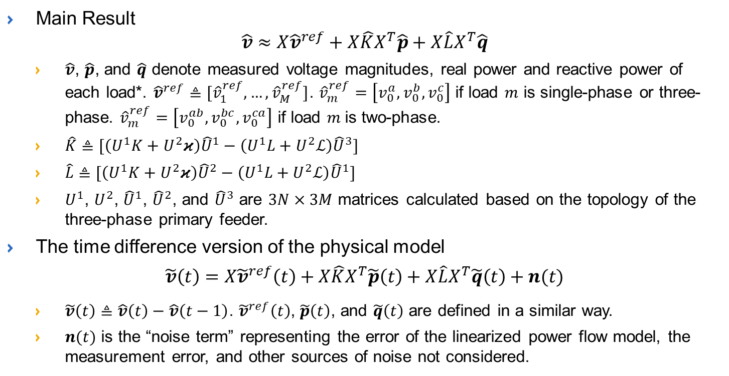
Link Phase Connections to Smart Meter Measurements
Main Result
$$\hat{v}≈X{\hat{v}}^{ref}+X\hat{K}X^{T}\hat{p}+X\hat{L}X^{T}\hat{q}$$
  $\hat{v}$, $\hat{p}$, and $\hat{q}$ denote measured voltage magnitudes, real power and reactive power of each load*. ${\hat{v}}^{ref}≜[{\hat{v}}_{1}^{ref},…,{\hat{v}}_{M}^{ref}]$. ${\hat{v}}_{m}^{ref}=\left[v_{0}^{a}, v_{0}^{b},v_{0}^{c}\right]$ if load $m$ is single-phase or three-phase. ${\hat{v}}_{m}^{ref}=\left[v_{0}^{ab}, v_{0}^{bc},v_{0}^{ca}\right]$ if load $m$is two-phase.
  $\hat{K}≜[\left(U^{1}K+U^{2}κ\right){\hat{U}}^{1}−\left(U^{1}L+U^{2}ℒ\right){\hat{U}}^{3}]$
  $\hat{L}≜[\left(U^{1}K+U^{2}κ\right){\hat{U}}^{2}−\left(U^{1}L+U^{2}ℒ\right){\hat{U}}^{1}]$
  $U^{1}$, $U^{2}$, ${\hat{U}}^{1}$, ${\hat{U}}^{2}$, and ${\hat{U}}^{3}$ are $3N×3M$ matrices calculated based on the topology of the three-phase primary feeder.
The time difference version of the physical model
$$\tilde{v}\left(t\right)=X{\tilde{v}}^{ref}\left(t\right)+X\hat{K}X^{T}\tilde{p}\left(t\right)+X\hat{L}X^{T}\tilde{q}\left(t\right)+n(t)$$
  $\tilde{v}\left(t\right)≜\hat{v}\left(t\right)−\hat{v}\left(t−1\right)$. ${\tilde{v}}^{ref}\left(t\right)$, $\tilde{p}\left(t\right)$, and $\tilde{q}\left(t\right)$ are defined in a similar way.
  $n(t)$ is the “noise term” representing the error of the linearized power flow model, the measurement error, and other sources of noise not considered.
* The derivation of measured voltage magnitudes, real power and reactive power from the corresponding variables can be found in the arXiv version of the paper.

Slide 43
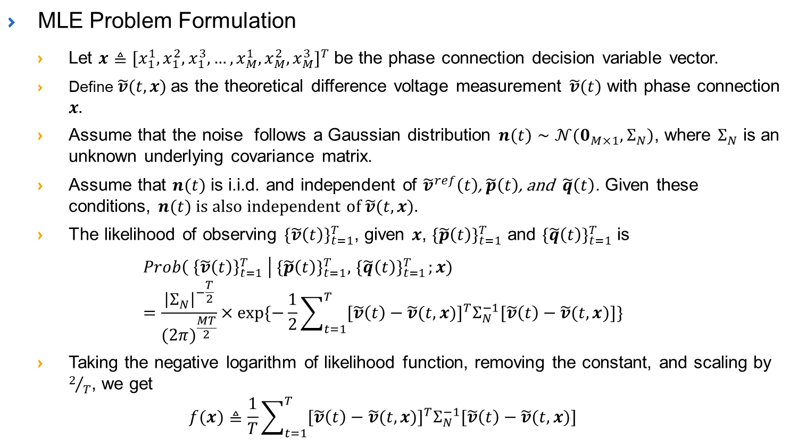
Formulate Phase Identification as a Maximum Likelihood Estimation (MLE) Problem
MLE Problem Formulation
  Let $x≜{[x_{1}^{1}, x_{1}^{2}, x_{1}^{3},…,x_{M}^{1},x_{M}^{2}, x_{M}^{3}]}^{T}$ be the phase connection decision variable vector.
  Define $\tilde{v}(t,x)$ as the theoretical difference voltage measurement $\tilde{v}(t)$ with phase connection $x.$
  Assume that the noise follows a Gaussian distribution $n(t)∼𝒩(0_{M×1},Σ_{N})$, where $Σ_{N}$ is an unknown underlying covariance matrix.
  Assume that $n(t)$ is i.i.d. and independent of ${\tilde{v}}^{ref}\left(t\right)$, $\tilde{p}\left(t\right)$, and $\tilde{q}\left(t\right)$. Given these conditions, $n(t)$ is also independent of $\tilde{v}(t,x)$.
  The likelihood of observing ${\{\tilde{v}\left(t\right)\}}_{t=1}^{T}$, given $x$, ${\{\tilde{p}\left(t\right)\}}_{t=1}^{T}$ and ${\{\tilde{q}\left(t\right)\}}_{t=1}^{T}$ is
  $$Prob\left({ \left\{\tilde{v}\left(t\right)\right\}}_{t=1}^{T} \right| {\{\tilde{p}\left(t\right)\}}_{t=1}^{T},{ \{\tilde{q}\left(t\right)\}}_{t=1}^{T};x)=\frac{{\left|Σ_{N}\right|}^{−\frac{T}{2}}}{{(2π)}^{\frac{MT}{2}}}×exp⁡\{−\frac{1}{2}\sum_{t=1}^{T}{{[\tilde{v}\left(t\right)−\tilde{v}(t,x)]}^{T}Σ_{N}^{−1}[\tilde{v}\left(t\right)−\tilde{v}(t,x)]}\}$$
  Taking the negative logarithm of likelihood function, removing the constant, and scaling by $2/T$, we get
  $$f(x)≜\frac{1}{T}\sum_{t=1}^{T}{{[\tilde{v}\left(t\right)−\tilde{v}(t,x)]}^{T}Σ_{N}^{−1}[\tilde{v}\left(t\right)−\tilde{v}(t,x)]}$$

Slide 44
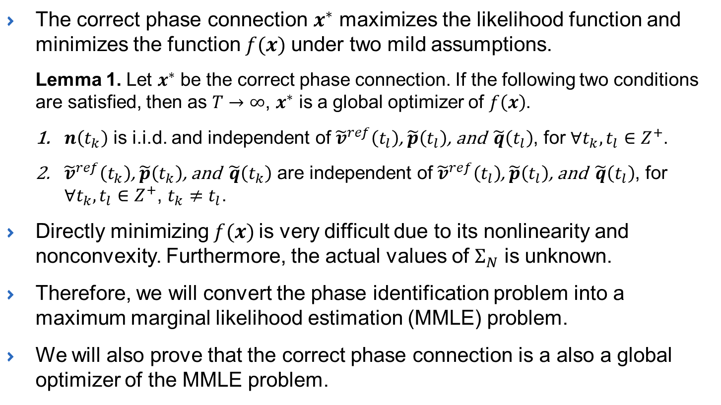
Theoretical Guarantee
The correct phase connection $x^{∗}$ maximizes the likelihood function and minimizes the function $f(x)$ under two mild assumptions.
  Lemma 1. Let $x^{∗}$ be the correct phase connection. If the following two conditions are satisfied, then as $T→∞$, $x^{∗}$ is a global optimizer of $f\left(x\right)$.
  $n\left(t_{k}\right)$ is i.i.d. and independent of ${\tilde{v}}^{ref}\left(t_{l}\right)$, $\tilde{p}\left(t_{l}\right)$, and $\tilde{q}\left(t_{l}\right)$, for $∀t_{k},t_{l}∈Z^{+}$.
  ${\tilde{v}}^{ref}\left(t_{k}\right)$, $\tilde{p}\left(t_{k}\right)$, and $\tilde{q}\left(t_{k}\right)$ are independent of ${\tilde{v}}^{ref}\left(t_{l}\right)$, $\tilde{p}\left(t_{l}\right)$, and $\tilde{q}\left(t_{l}\right)$, for $∀t_{k},t_{l}∈Z^{+}$, $t_{k}≠t_{l}$.
Directly minimizing $f(x)$ is very difficult due to its nonlinearity and nonconvexity. Furthermore, the actual values of $Σ_{N}$ is unknown.
Therefore, we will convert the phase identification problem into a maximum marginal likelihood estimation (MMLE) problem.
We will also prove that the correct phase connection is a also a global optimizer of the MMLE problem.

Slide 45
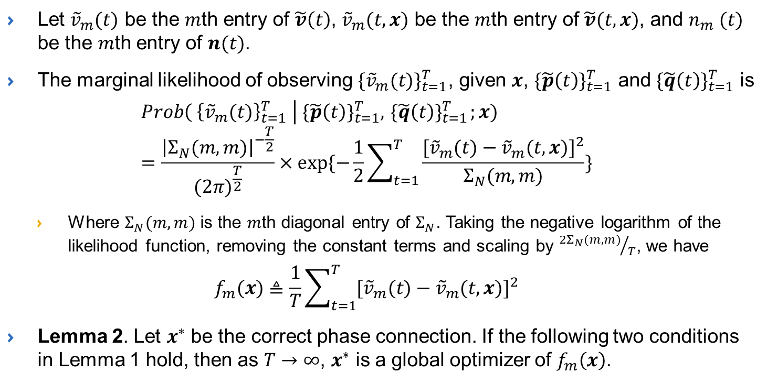
Phase Identification as a Maximum Marginal Likelihood Estimation (MMLE) Problem
Let ${\tilde{v}}_{m}(t)$ be the $m$th entry of $\tilde{v}\left(t\right)$, ${\tilde{v}}_{m}(t,x)$ be the $m$th entry of $\tilde{v}(t,x)$, and $n_{m} (t)$ be the $m$th entry of $n(t)$.
The marginal likelihood of observing ${\{{\tilde{v}}_{m}(t)\}}_{t=1}^{T}$, given $x$, ${\{\tilde{p}\left(t\right)\}}_{t=1}^{T}$ and ${\{\tilde{q}\left(t\right)\}}_{t=1}^{T}$ is
  $$Prob\left({ \left\{{\tilde{v}}_{m}(t)\right\}}_{t=1}^{T} \right| {\{\tilde{p}\left(t\right)\}}_{t=1}^{T},{ \{\tilde{q}\left(t\right)\}}_{t=1}^{T};x)=\frac{{\left|Σ_{N}(m,m)\right|}^{−\frac{T}{2}}}{{(2π)}^{\frac{T}{2}}}×exp⁡\{−\frac{1}{2}\sum_{t=1}^{T}{\frac{{[{\tilde{v}}_{m}(t)−{\tilde{v}}_{m}(t,x)]}^{2}}{Σ_{N}(m,m)}}\}$$
  Where $Σ_{N}(m,m)$ is the $m$th diagonal entry of $Σ_{N}$. Taking the negative logarithm of the likelihood function, removing the constant terms and scaling by ${2Σ_{N}(m,m)}/T$, we have
  $$f_{m}(x)≜\frac{1}{T}\sum_{t=1}^{T}{{[{\tilde{v}}_{m}(t)−{\tilde{v}}_{m}(t,x)]}^{2}}$$
  Lemma 2. Let $x^{∗}$ be the correct phase connection. If the following two conditions in Lemma 1 hold, then as $T→∞$, $x^{∗}$ is a global optimizer of $f_{m}\left(x\right)$.

Slide 46
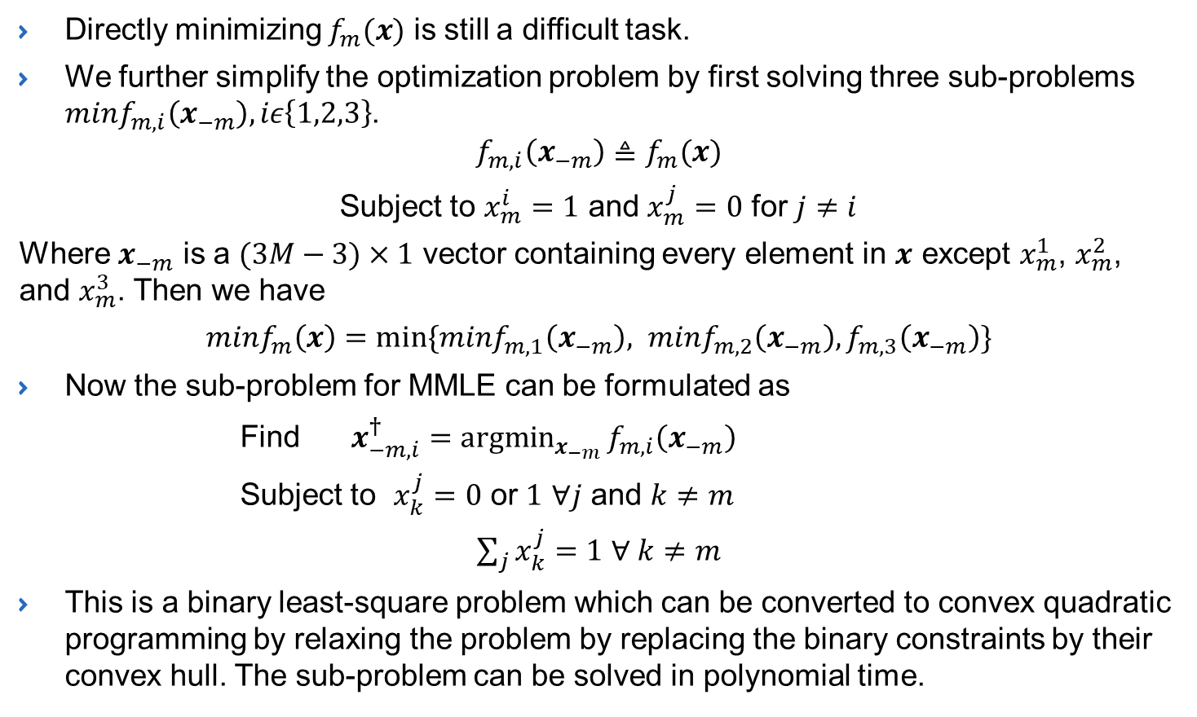
Solution Method
Directly minimizing $f_{m}(x)$ is still a difficult task.
We further simplify the optimization problem by first solving three sub-problems $minf_{m,i}\left(x_{−m}\right), iε\left\{1,2,3\right\}$.
$$f_{m,i}\left(x_{−m}\right)≜f_{m}(x)$$
Subject to $x_{m}^{i}=1$ and $x_{m}^{j}=0$ for $j≠i$
Where $x_{−m}$ is a $(3M−3)×1$ vector containing every element in $x$ except $x_{m}^{1}$, $x_{m}^{2}$, and $x_{m}^{3}$. Then we have
$minf_{m}\left(x\right)=min⁡\{minf_{m,1}\left(x_{−m}\right), minf_{m,2}\left(x_{−m}\right),f_{m,3}\left(x_{−m}\right)\}$
Now the sub-problem for MMLE can be formulated as
Find $x_{−m,i}^{†}=\underset{x_{−m}}{argmin}{f_{m,i}\left(x_{−m}\right)}$
Subject to $x_{k}^{j}=0$ or $1$ $∀j$ and $k≠m$
$\sum_{j}{x_{k}^{j}}=1$ $∀ k≠m$
This is a binary least-square problem which can be converted to convex quadratic programming by relaxing the problem by replacing the binary constraints by their convex hull. The sub-problem can be solved in polynomial time.

Slide 47
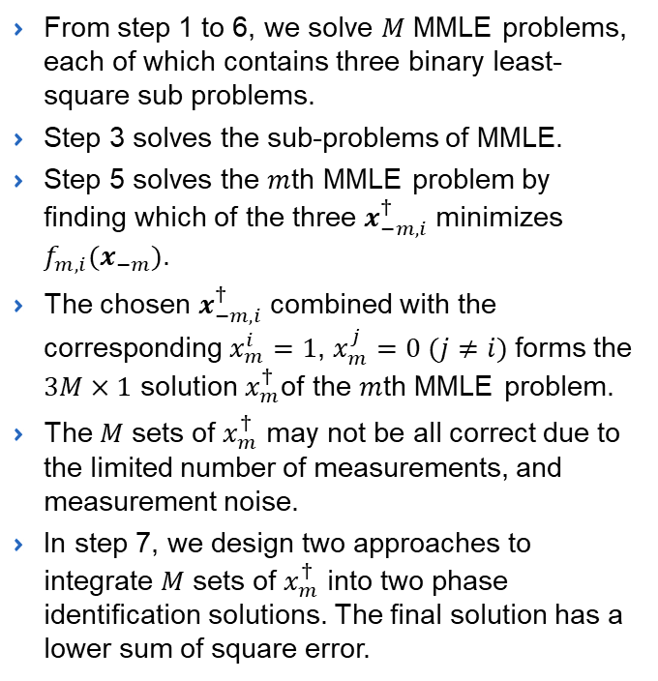
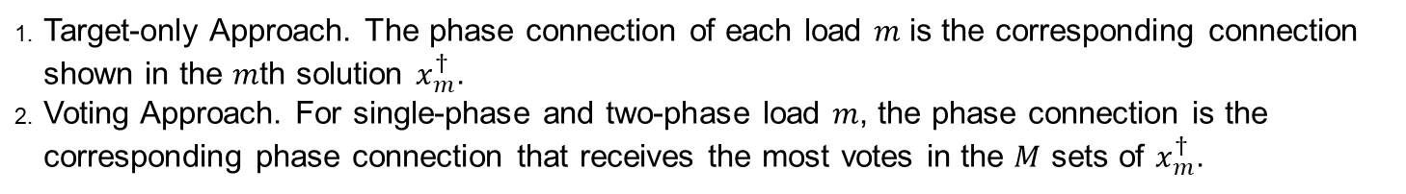
Summary of Solution Algorithm
From step 1 to 6, we solve $M$ MMLE problems, each of which contains three binary least-square sub problems.
Step 3 solves the sub-problems of MMLE.
Step 5 solves the $m$th MMLE problem by finding which of the three $x_{−m,i}^{†}$ minimizes $f_{m,i}(x_{−m})$.
The chosen $x_{−m,i}^{†}$ combined with the corresponding $x_{m}^{i}=1$, $x_{m}^{j}=0 (j≠i)$ forms the $3M×1$ solution $x_{m}^{†}$of the $m$th MMLE problem.
The $M$ sets of $x_{m}^{†}$ may not be all correct due to the limited number of measurements, and measurement noise.
In step 7, we design two approaches to integrate $M$ sets of $x_{m}^{†}$ into two phase identification solutions. The final solution has a lower sum of square error.
Target-only Approach. The phase connection of each load $m$ is the corresponding connection shown in the $m$th solution $x_{m}^{†}$.
Voting Approach. For single-phase and two-phase load $m$, the phase connection is the corresponding phase connection that receives the most votes in the $M$ sets of $x_{m}^{†}$.

Slide 48
Numerical Study Setup
Test Circuits (Modified IEEE distribution feeders)
  Radial primary: IEEE 37-bus, 123-bus & heavily meshed primary: 342-bus.
Feeder | A | B | C | AB | BC | CA | ABC | Total
37-bus | 5 | 5 | 6 | 3 | 2 | 2 | 2 | 25
123-bus | 18 | 17 | 17 | 9 | 9 | 10 | 5 | 85
342-bus | 30 | 38 | 31 | 35 | 31 | 33 | 10 | 208
Number of Loads per Phase in the IEEE Test Circuits
Smart Meter Data
  Length: 90 days of hourly average real power consumption data (2160 data points)
  Source: a distribution feeder managed by FortisBC.
Power Flow Simulated with OpenDSS to Generate Theoretical Nodal Voltage
Measurement noise follows a zero-mean Gaussian distribution with three-sigma deviation matching 0.1% and 0.2% of nominal values. (0.1 and 0.2 accuracy class smart meters established in ANSI.)
After applying measurement noise, the voltage measurements are rounded to the nearest 1 V for the primary loads and 0.1 V for the secondary loads to make the phase identification task more difficult.

Slide 49
Phase Identification Algorithm Performance
Accuracy of the Proposed Phase Identification Method
Feeder | Meter Class | 30 days | 60 days | 90 days
37-bus (radial) | 0.1% | 100% | 100% | 100%
 | 0.2% | 92% | 100% | 100%
123-bus (radial) | 0.1% | 96.47% | 100% | 100%
 | 0.2% | 63.53% | 96.47% | 100%
342-bus (meshed) | 0.1% | 96.63% | 100% | 100%
 | 0.2% | 72.60% | 99.52% | 100%
The performance of the proposed MMLE-based algorithm on three IEEE distribution test circuits, two meter accuracy classes, and three time windows are shown here.
With 90 days of hourly meter measurements, the proposed algorithm achieved 100% accuracy for all three circuits. (Works well for radial and meshed circuits).
Phase identification accuracy increases as smart meter measurement error decreases and addition smart meter data becomes available.

Slide 50
Comparison with Existing Methods
Phase Identification Accuracy of Different Methods with 90 days of Meter Data
Method | Meter Class | 37-Bus Feeder | 123-Bus Feeder | 342-Bus Feeder
Correlation-based Approach* | 0.1% | 100% | 98.75% | 81.82%
 | 0.2% | 100% | 97.5% | 81.31%
Clustering-based Approach# | 0.1% | 100% | 100% | 93.43%
 | 0.2% | 100% | 98.75% | 91.41%
MMLE-based Algorithm | 0.1% | 100% | 100% | 100%
 | 0.2% | 100% | 100% | 100%
The proposed MMLE-based algorithm outperforms the correlation and clustering-based approaches.
The improvement in accuracy increases as the complexity of the distribution feeder increases.
* M. Xu, R. Li, and F. Li, “Phase identification with incomplete data,” IEEE Transactions on Smart Grid, vol. 9, no. 4, pp. 2777-2785, 2018
  # W. Wang and N. Yu, "AMI Data Driven Phase Identification in Smart Grid," the Second International Conference on Green Communications, Computing and Technologies, pp. 1-8, Rome, Italy, Sep. 2017.

Slide 51
Conclusion
Develop a physically inspired data-driven algorithm for the phase identification in power distribution system.
The phase identification problem is formulated as an MLE and MMLE problem based on the three-phase power flow manifold.
We prove that the correct phase connection is a global optimizer for both the MLE and the MMLE problems.
A computationally efficient algorithm is developed to solve the MMLE problem, which involves synthesizing the solutions from the sub-problems.
Comprehensive simulation results show that our proposed algorithm yields high accuracy and outperforms existing methods.

Slide 52
The Center for Grid Engineering Education - Short Course: Big Data Analytics and Machine Learning in Smart Grid
Date: May 9th 8:00 am – 5:00 pm
Location: Hilton St. Louis at The Ballpark
1 South Broadway, Gateway Ballroom
St. Louis, Missouri
PDH’s available: 8 hours
Registration Fee charged by EPRI
  $800 per person
  20% discount for organizations with three or more attendees
  25% discount for government employees (non-utility)
  25% discount for university professors*
  75% discount for graduate students*
  *University IDs required to qualify for professor or graduate student discounts.
https://intra.ece.ucr.edu/~nyu/Teaching/ML-BD-Smart-Grid_2019.pdf

Slide 53
The Center for Grid Engineering Education - Short Course: Big Data Analytics and Machine Learning in Smart Grid
EPRI Contacts: Amy Feser, afeser@epri.com
(865) 218-5909
Course Topics: Big Data Analytics and Machine Learning
  Distribution System
    Topology Identification
    Theft Detection
    Predictive Maintenance of Distribution Equipment
    Estimation of Behind-the-meter Solar Generation
    Reinforcement Learning based Volt-VAR Control and Network Reconfiguration
  Electricity Market
    Algorithmic Trading with Virtual Bids in Electricity Market
  Transmission System
    Anomaly Detection with PMU Data
    Motifs and Signatures Discovery with PMU Data
    Segmentation of PMU Data
https://intra.ece.ucr.edu/~nyu/Teaching/ML-BD-Smart-Grid_2019.pdf

Slide 54
Thank You
Contact information
  Dr. Nanpeng Yu
  Department of Electrical and Computer Engineering, UC Riverside, United States
  Phone: 951.827.3688
  Email: nyu@ece.ucr.edu
  Website: http://www.ece.ucr.edu/~nyu/

