Slide 1

Improve grid edge awareness with continuous waveform recording
Richard D. Kirby, Senior Engineer

Slide 2


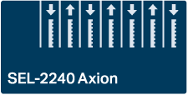
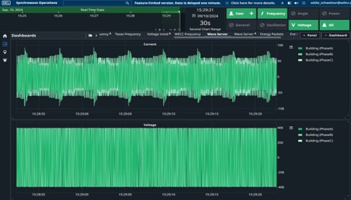


Continuous waveform streaming and recording – DFRs, PQMs, and PMs
Controller
Software application
3 ksps
DFR WMU
3 ksps
PQM WMU
CWR PC
SEL-T35
14.4 ksps
PM WMU
Notes:
DFR WMU: DFR CT/PT cards for 3 ksps continuous waveform streaming
PQM WMU : Power Quality and Revenue Meter combines revenue and PQ with 3 ksps continuous waveform streaming
PM WMU : Power Monitor measures ac and dc power with conversion with 14.4 ksps continuous waveform streaming

Slide 3




Integrate various measurement rates from relays, meters, PMUs, and WMUs
Software application
CWR PC
WMU

Slide 4

Triggerless recording captures every disturbance
Use case 1
Trigger
Recording device
Traditional
Duration
Continuous waveform recording

Slide 5
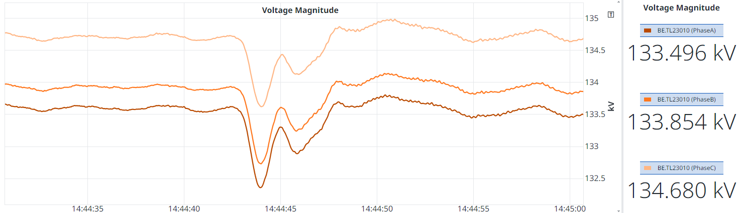
Trigger dependent systems can miss events
Traditional
Continuous recording

Slide 6
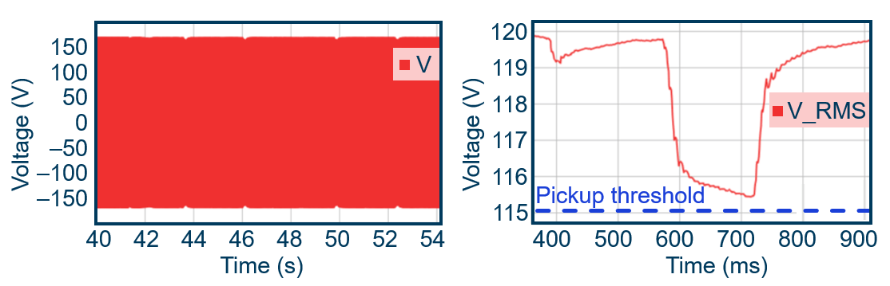
Capture voltage-induced flicker missed by traditional monitoring

Slide 7
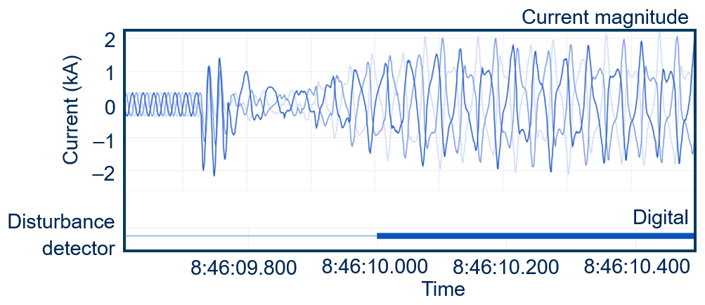
Increase visibility of power system dynamics
Use case 2

Slide 8
AI training runs create large load changes that can induce resonance
150 MW
Small city
15 MW
10
20
30
40
50
Time (s)

Slide 9
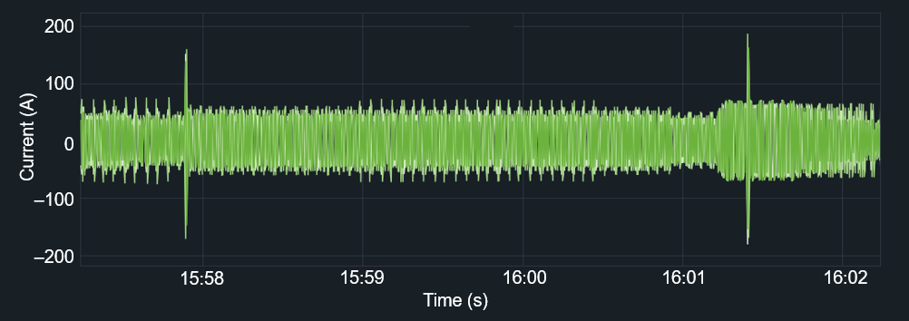
Identify equipment failure early
Use case 3
Notes:
Coming soon: Diagram or set of figures that demonstrate precursor events often identify failures early

Slide 10
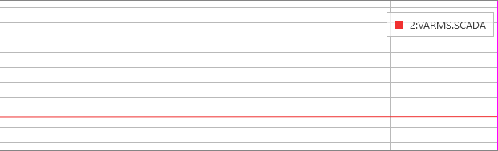
Three-second SCADA misses transient
SCADA
9,200
2:VARMS.SCADA
8,800
8,400
RMS voltage
8,000
7,600
0
100
200
300
Time (ms)

Slide 11
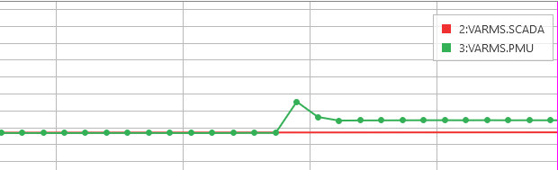
60 messages/second PMU data starts to see transient
PMU
9,200
2:VARMS.SCADA
3:VARMS.PMU
8,800
8,400
RMS voltage
8,000
7,600
0
100
200
300
Time (ms)

Slide 12
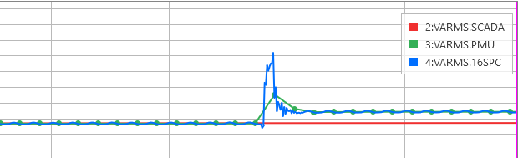
Relay event reports approximate transient
16 samples per cycle
9,200
2:VARMS.SCADA
3:VARMS.PMU
8,800
4:VARMS.16SPC
8,400
RMS voltage
8,000
7,600
0
100
200
300
Time (ms)

Slide 13
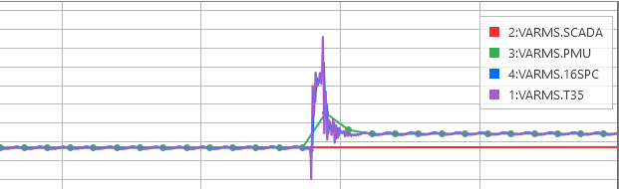
Continuous recording at 14.4 ksps captures peak and ringing
14.4 ksps
9,200
2:VARMS.SCADA
3:VARMS.PMU
8,800
4:VARMS.16SPC
8,400
5:VARMS.T35
RMS voltage
8,000
7,600
0
100
200
300
Time (ms)

Slide 14
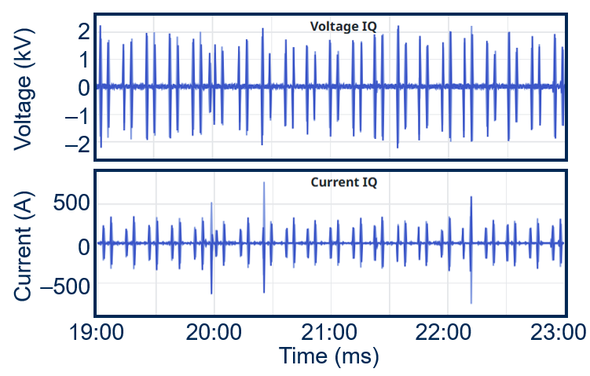
Visualize hours of transients on one timeline

Slide 15

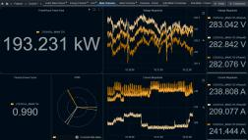

Software derived PMU and SCADA metering applications
Quantity | Description
V, I, and Φ | 1 cycle rms, fundamental
Frequency | 1/2 cycle frequency
P, Q, and S | 1 cycle rms, fundamental
Symmetrical components | 1 cycle rms
SSO/SSR | 5 – 45 Hz
Harmonics | 25th or 100th
Continuous waveform
recording
PMU and SCADA metering

Slide 16
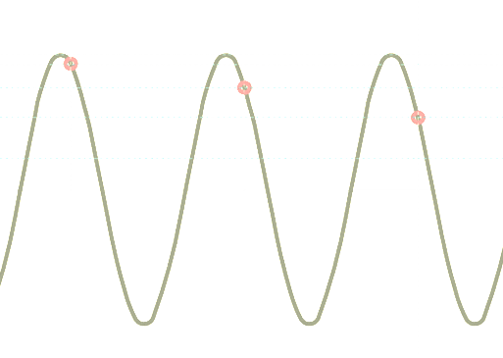
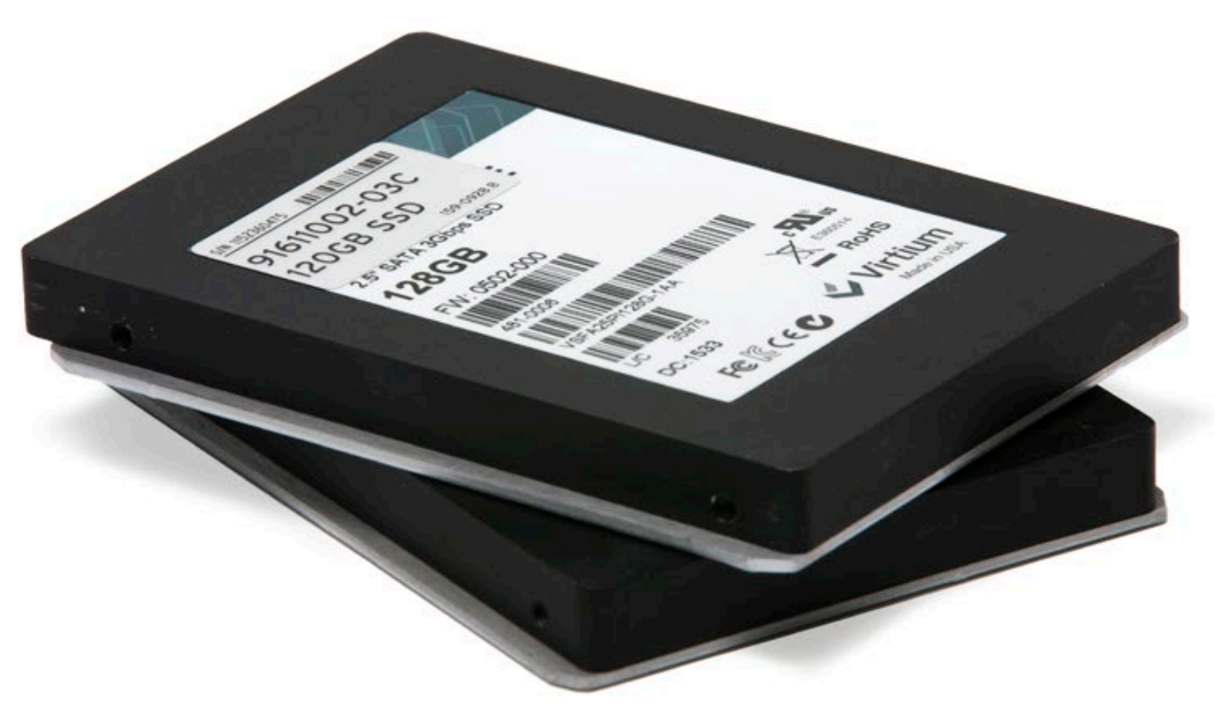
Consider network bandwidth and storage when streaming and recording ksps data
Model | Sample rate (ksps) | Channels | Network bandwidth (kbps) | Storage per channel (GB per day)
Meter | 3.0 | 6 | 600 | 1
DFR | 3.0 | 96 | 9,700 | 1
Monitor | 14.4 | 17 | 11,100 | 5

Slide 17
THANK YOU
Richard D. Kirby
Richard_Kirby@selinc.com
+1.509.334.8150

