Slide 1

Detecting Anomalies in Waveform Measurements for Fire Prevention in Distribution Systems
Jhi-Young Joo

Slide 2
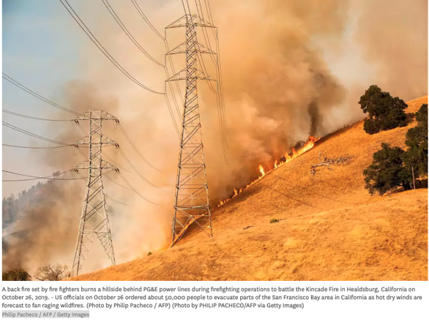
Fires caused by electric equipment
Impacts can be catastrophic, but they are preventable
Causes
  Foreign object (e.g., vegetation) contact, Conductor slapping, Broken conductor, Equipment failure
Challenges
  Traditional fault detection and protection scheme
  Complex distribution systems
Mitigations
  Vegetation maintenance, fire monitoring, covered conductors and undergrounding
  Covered conductors/undergrounding
  Novel fault detection strategies
https://www.sfchronicle.com/california-wildfires/article/Judge-orders-PG-E-to-answer-questions-about-14808297.php

Slide 3
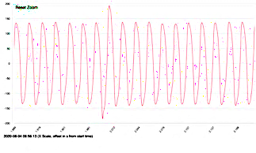
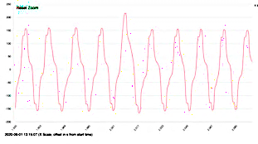
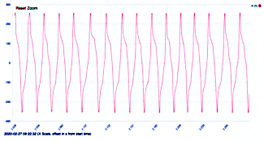
Detect early signs of failure with waveform measurements
Low-current arcing signatures
Data source: DOE Grid Event Signature Library (GESL) https://gesl.ornl.gov

Slide 4
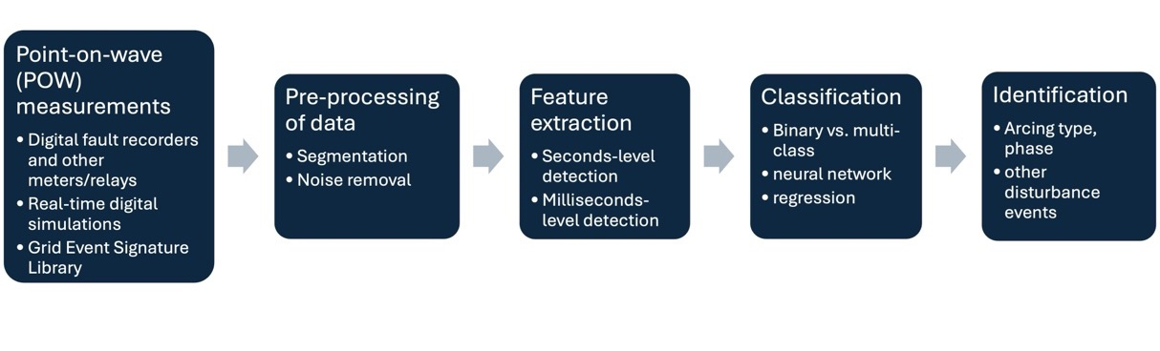
Analytics approach
Feature extraction from cycles-level signals, binary classification
Discrete wavelet transform

Slide 5
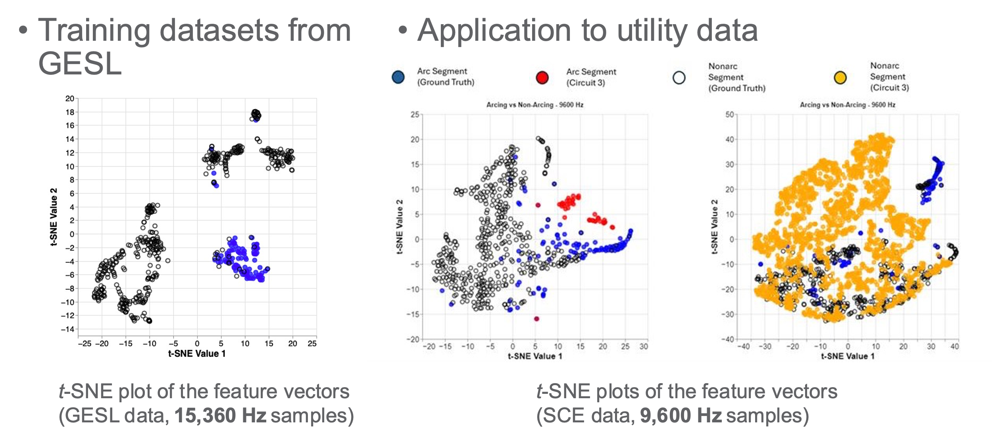
Classification results
Up to 90% accuracy on training datasets
Validated across different datasets and resolutions

Slide 6





Acknowledgment

Slide 7

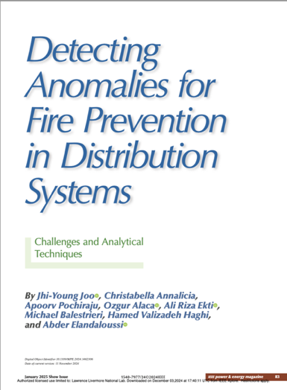
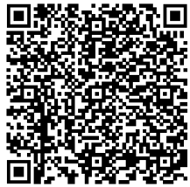
For more details
https://magazines.ieee.org/pe/library/item/2025_grid_edge_conference/4235173/?mkt_tok=NzU2LUdQSC04OTkAAAGX6sf5wZtj8fy2ELHyY4997exgLBF71kgvSb_CMWdwxrtToaO3K_LWicM5k88lLD9eghFieOHUNc7GC7xlsATIIRW0iPMia0an1otUYfDdl0nrstoNXIGygA

Slide 8
THANK YOU
Jhi-Young Joo, Ph.D.
joo3@llnl.gov
Grid Data Analytics Area Lead
This work was performed under the auspices of the U.S. Department of Energy by Lawrence Livermore National Laboratory under contract DE-AC52-07NA27344. Lawrence Livermore National Security, LLC

