Slide 1
GridSweep:
Using Synchro-Waveforms to Probe Distribution Grid Stability from 120V Outlets
Alex McEachern, IEEE Life Fellow

Slide 2
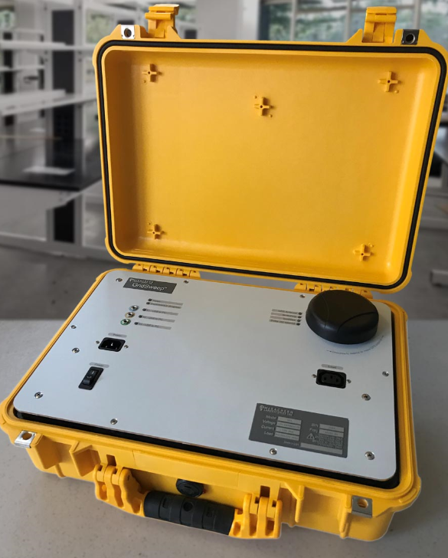
GridSweep is a new type of grid research instrument.
4-year $4M U.S. Dept of Energy project
100% open-source
Hardware, firmware, software, data
LBNL has a loaner fleet of GridSweep instruments available.
Two independent grid edge functions:
Synchroprobing the grid via 120-volt outlets.
Recording voltage synchrowaveforms on 120-volt outlets, at parts-per-billion resolution.

Slide 3
GridSweep applications
Using only grid edge (120-volt outlet) measurements:
Confirmed: Measure risk of instability on IBR-intensive feeders.
Research opportunity: Microdisturbances: Map real-time grid configuration. Detect grid ignition faults.
Research opportunity: Detect substation cyberattack rehearsals using source impedance changes

Slide 4
New ideas about grid impedances
???
What about R(f)? L(f)?
What if the load impedance is negative?
Traditional grid measurements: voltages, currents, power flows.
Source impedance measurements were generally limited to arc-flash risks and protection device ratings. But now other concerns are emerging.
Traditional source impedance: transmission/distribution transformers & lines, and to a lesser extent generators.
But now we have distributed generation and reconfigurable grids (and negative impedance loads like EV chargers, AI data centers, etc.)
Traditional source impedance: 50/60 Hz, or maybe up to 3 kHz(?)
But now we have important sub-synchronous (say, 1 Hz – 40 Hz) impedance concerns for stability and substation cyberattack detection

Slide 6
Measure risk of instability: active grid probing methods
 |  | Source | Stimulus | Measurement devices | Measurement resolution | Noise extraction method
1980s- |  | Chief Joseph Brake | 1 GW impulse | Fault recorders | 1000 ppm 0.1% | None
2015- |  | Grid Thumper | 1 MW impulse | microPMUs | 10 ppm 0.001% | Time-synchronous demodulation
2022- |  | GridSweep | 1 kW swept sine | GridSweep | 6 ppb 0.0000006% | Single frequency vector-synchronous demodulation

Slide 7
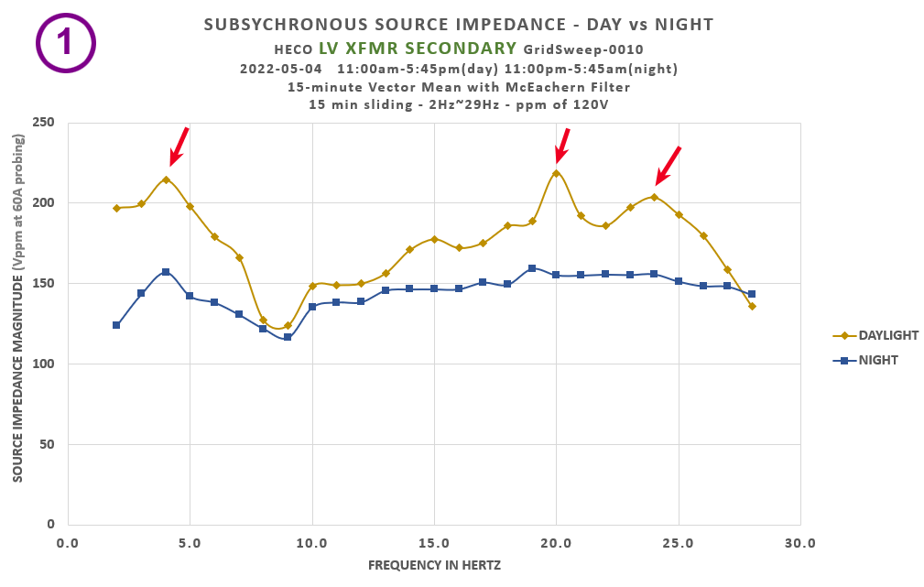
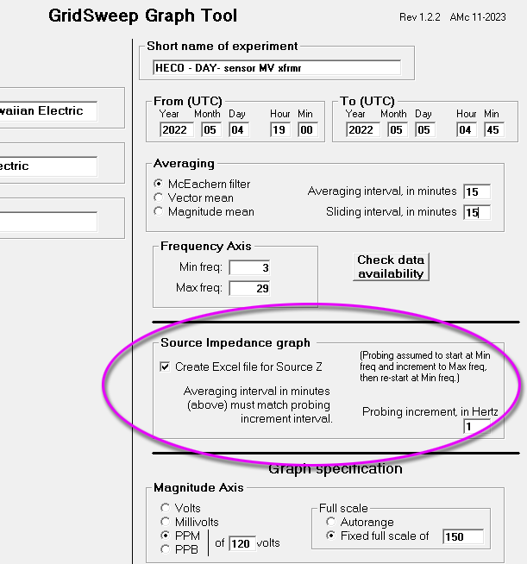
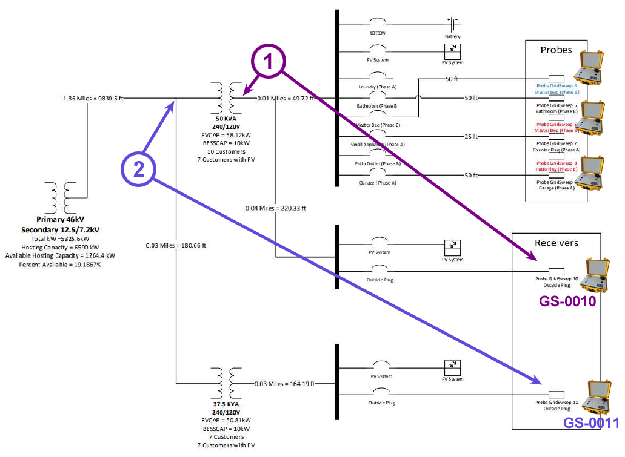
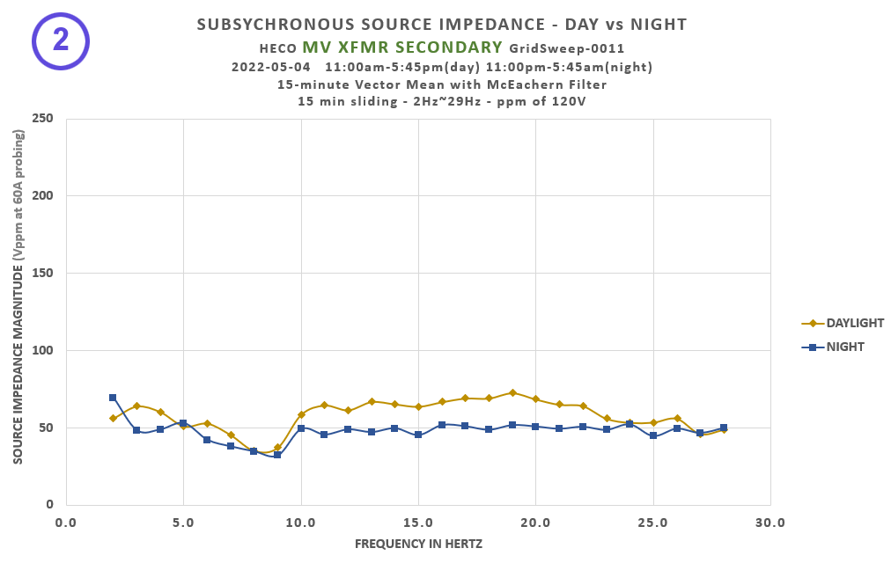
Measure risk of instability: GridSweep results for IBR’s

Slide 8
“Microdisturbances for grid state measurement” A proposed new application for grid edge synchrowaveforms.
Red: Medium voltage Blue: Grid edge voltage (120V)
Source of graph:
Prof. Hamed Mohsenian-Rad
U.C. Riverside

Slide 9
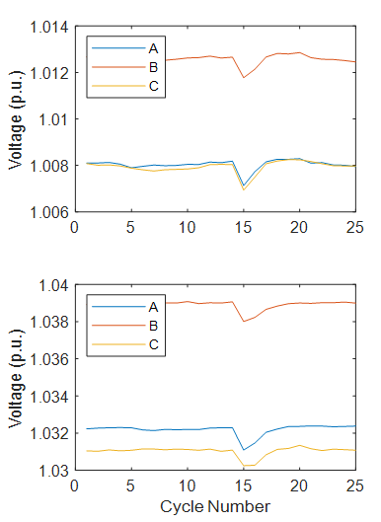
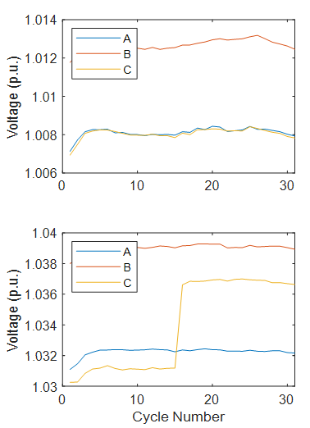
“Microdisturbance” concept & application
Proposed definition of “microdisturbance”:
any power quality disturbance that is detectable, but is too tiny to disrupt or damage any sensitive load.
^{Microdisturbance #1}
^{Microdisturbance #2}
^{Microdisturbance #3}
^{Medium voltage RMS}
^{Medium voltage RMS}
Red: Medium voltage Blue: Grid edge voltage (120V)
^{Grid edge voltage RMS (120V)}
Cheap & simple & easy-to-install sensors should be developed.
Grid state estimation consists of correlation between simultaneously observed grid-edge microdisturbances, observed at a population of locations around the grid.
What does it take for real-time corellation?
^{Grid edge voltage RMS (120V)}
Source of graphs:
Prof. Hamed Mohsenian-Rad
U.C. Riverside

Slide 10
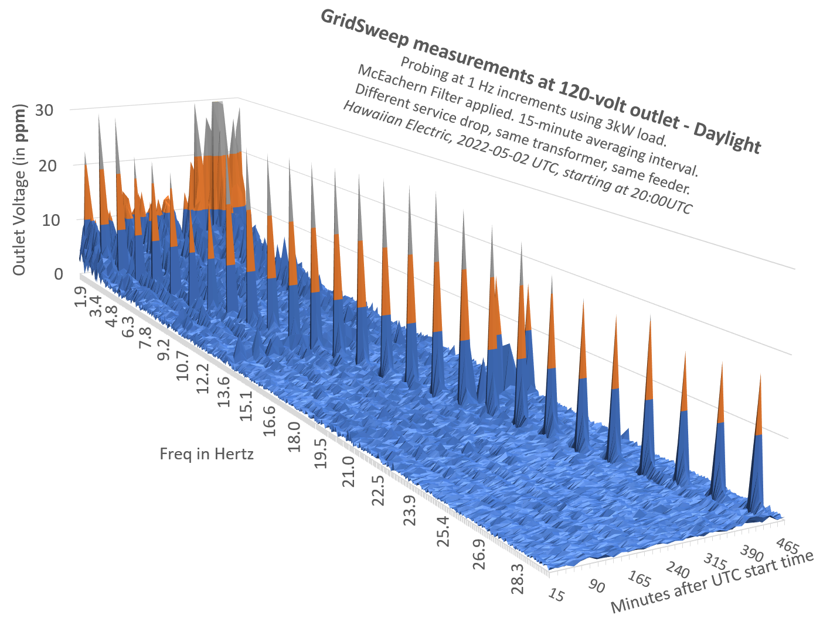
Microdisturbance correlation: Computing & comms required for ‘n’ GridSweep-scale 120-volt sensors
Pairs of sensors to be correlated: (n²-n)/2 pairs Data comms per sensor: 10⁻¹ megabytes/sec
Real-time correlation computing power required per pair of sensors: ~ 4 x 10⁻² megaFLOPs
Example: n=100 sensors Pairs of sensors ~ 1 x 10⁴ 4 x 10² megaFLOPS 1 x 10² megabytes/sec
Example: n=40,000 sensors Pairs of sensors ~ 1 x 10⁹ 4 x 10⁷ megaFLOPS 4 x 10³ megabytes/sec
 |  | Computer | Cost | Calculation power: megaFLOPs | Ethernet comms speed: Megabytes/sec
2024 |  | Powerful desktop workstation | US$5k | 1 x 10³ | 1 x 10²
2025 |  | Re-purposed Artificial Intelligence workstation | US$50k | 5 x 10⁹ | 2 x 10⁴

Slide 11
Three calls for action!

Slide 12
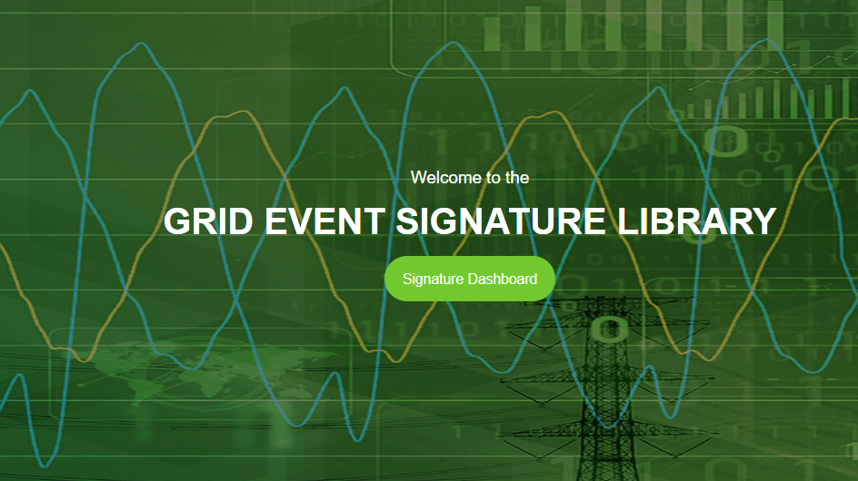
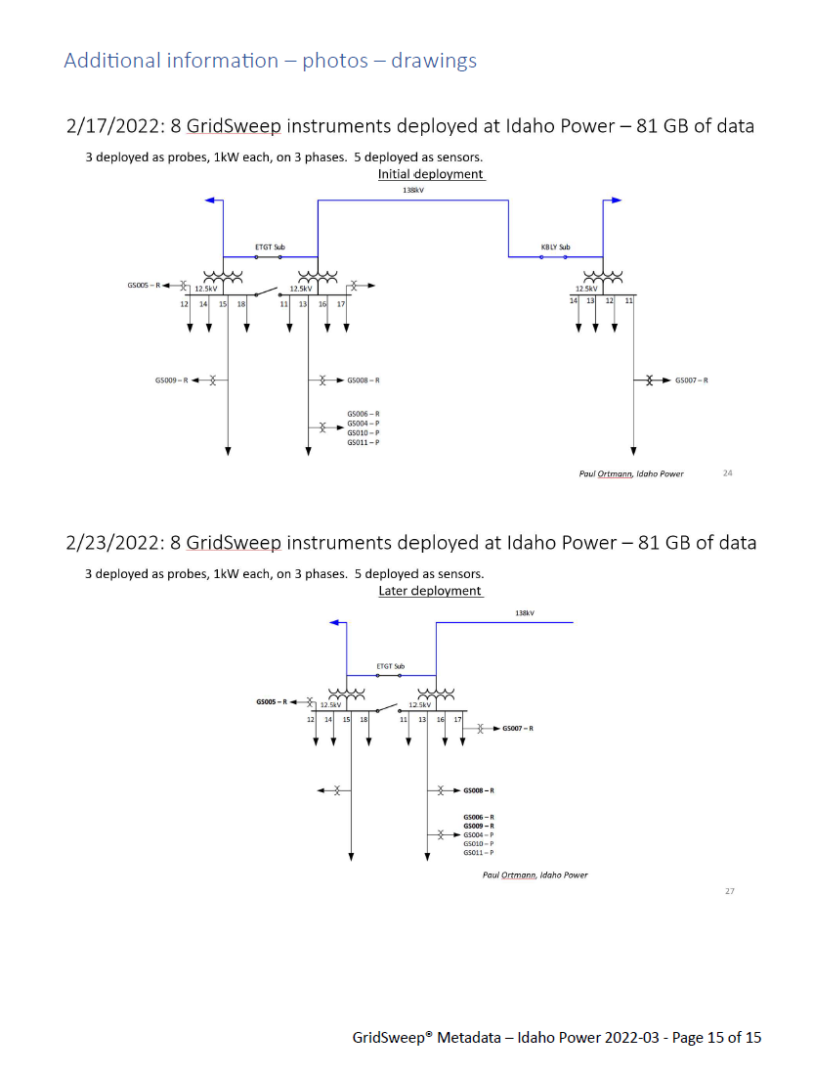
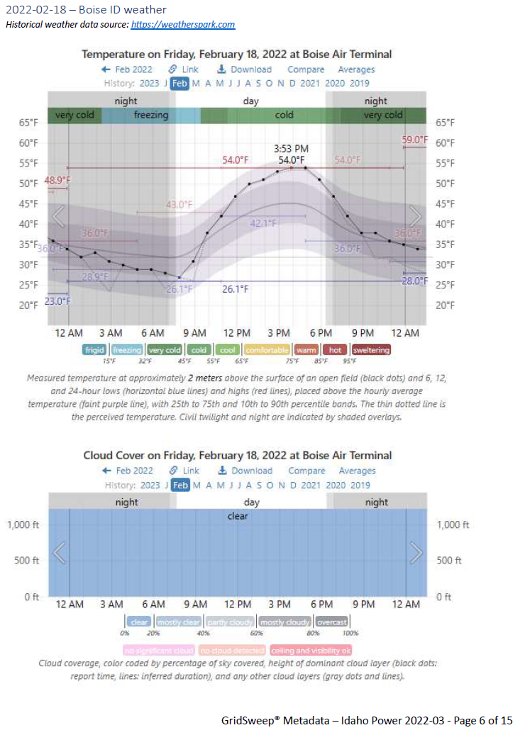
Calls for action! (1)
Need FREE real-world grid edge synchrowaveform data?
Download from ORNL’s GESL. Hundreds of gigabytes available, from a variety of distribution grids, complete with metadata.
GESL.ORNL.GOV

Slide 13
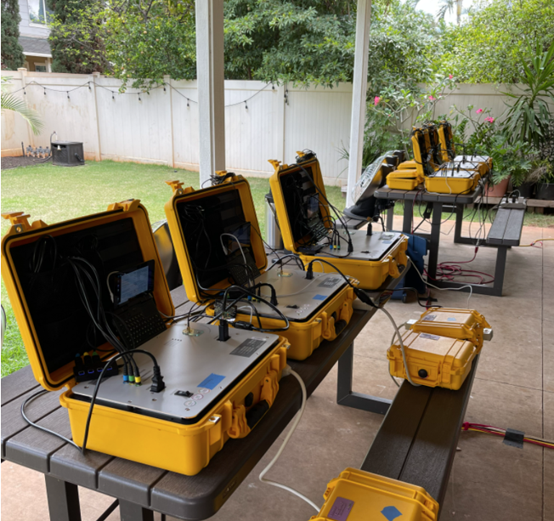
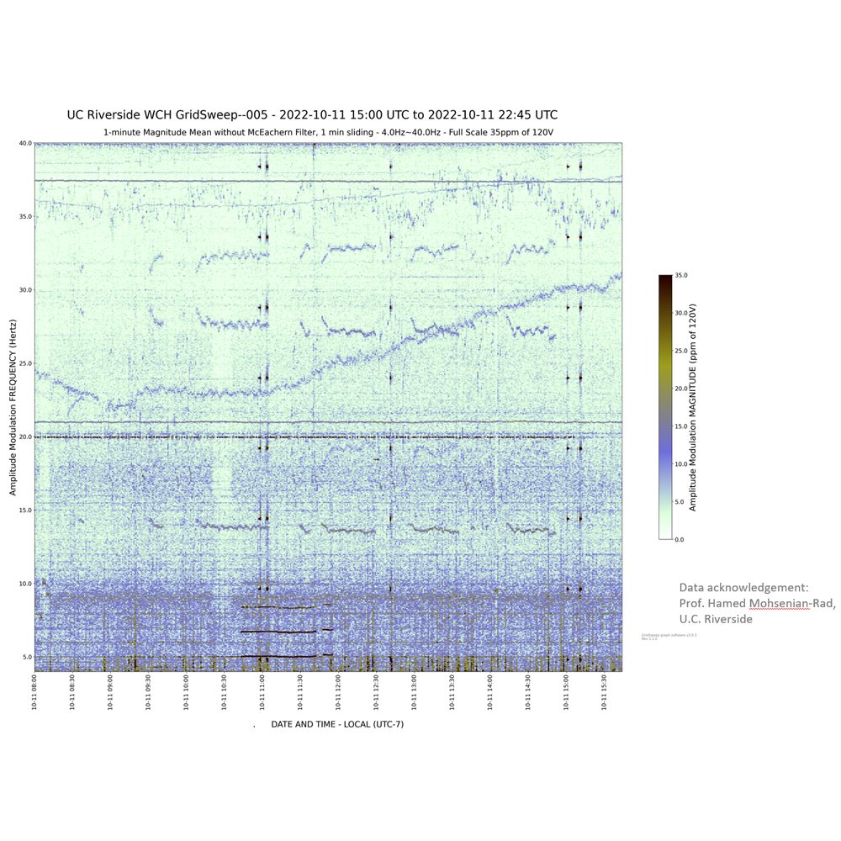
Calls for action! (2)
Have an interesting idea? LBNL has a fleet of GridSweep instruments specifically for loaning out to National Labs, universities, utilities…
GridSweep data – 8-hour, 5Hz - 40Hz ,heat map at U.C. Riverside

Slide 14
Calls for action! (3)
Discuss a grid-mapping microdisturbance project? I can connect and advise. (In my opinion, this is the important opportunity.)
Discuss measurements for detecting rehearsals of substation cyberattacks? Private discussion.
ALEX@MCEACHERN.com
+1-510-295-8264

Slide 15
Thank you.
Alex McEachern, IEEE Life Fellow
ALEX@MCEACHERN.com
+1-510-295-8264

